Slide 1
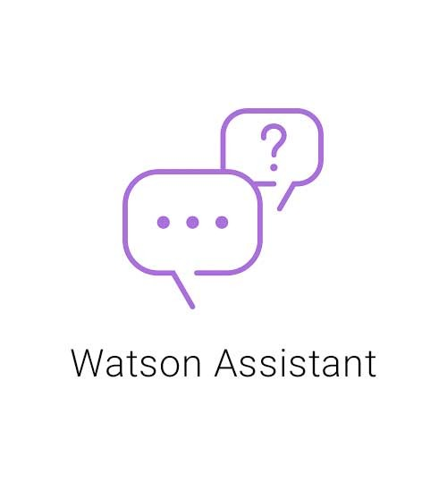


Watson Assistant & Alexa connection using OpenWhisk - Step by Step Guide

Slide 2
Structure
Overview: How it works
Create Watson Assistant
Install Cloud Functions
Create Alexa Skill
Set IBM Cloud Account Preferecnes
Create Open Whisk Action
Configure Webhook
Access public Google Calendar
Create Open Whisk Action

Slide 3
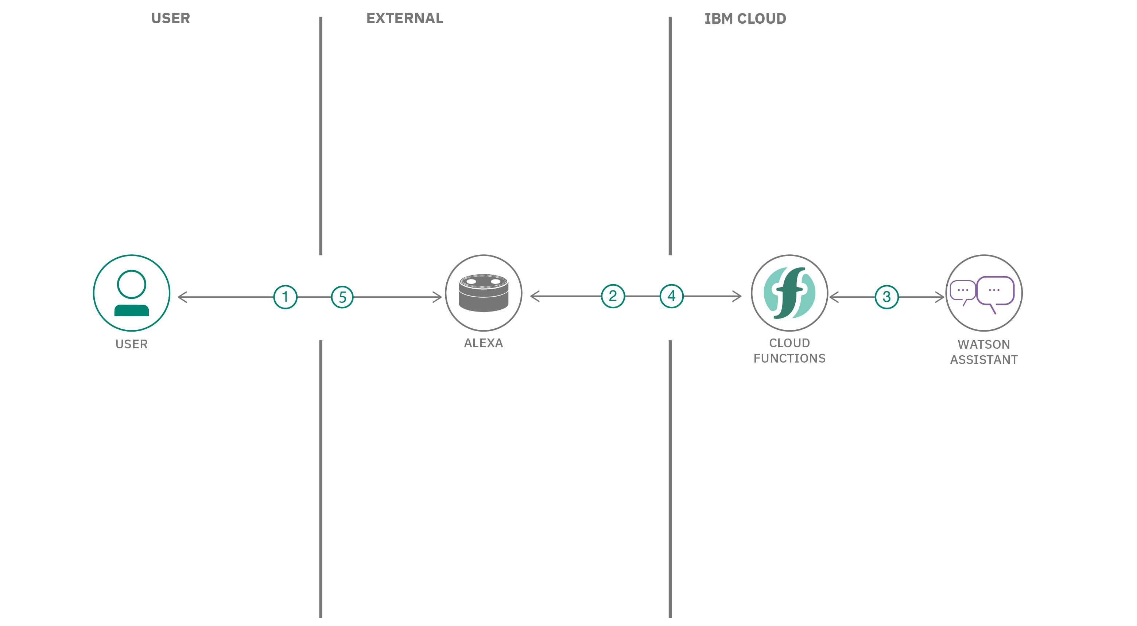
Overview: How it works
User talks to Alexa
Alexa sends a REST request to Watson Assistant via the Cloud Function, which contains the user's question in JSON format
Watson Assistant evaluates the question and sends the answer (as JSON) back to Alexa via the Cloud Function
Alexa reads out the received answer
source: https://developer.ibm.com/depmodels/serverless/patterns/create-an-alexa-skill-with-serverless-and-a-conversation/

Slide 4
IBM Cloud Account Preferecnes
Sign up for IBM Cloud if you don't have an IBM Cloud account yet (https://cloud.ibm.com/registration).
First, a Cloud Foundry organization and a space must be created. Without the organization and space it is not possible to generate the endpoint link for the Alexa Skill.

Slide 5
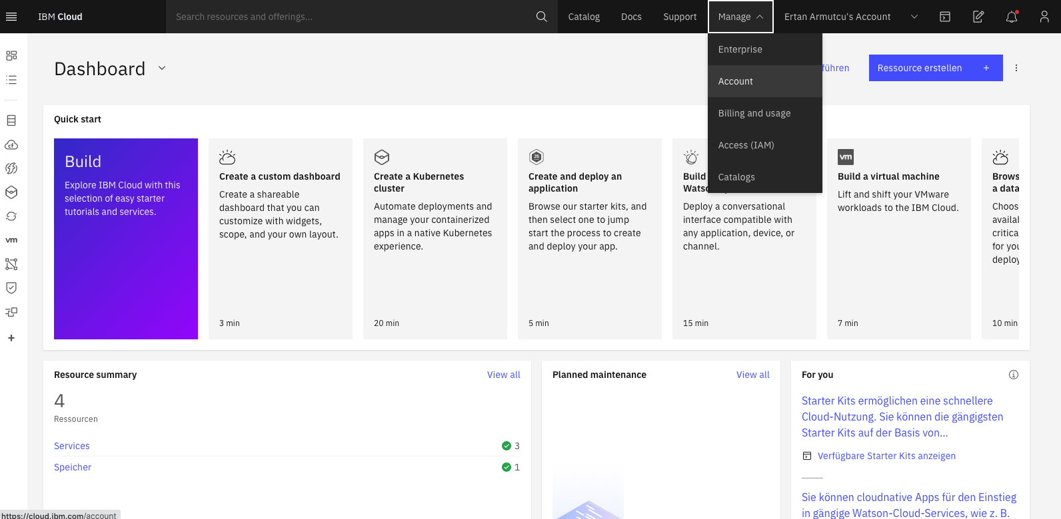
IBM Cloud Account Preferecnes
Open your IBM Cloud Dashboard and click on and click on Manage → Account on the top navigation bar as shown in the picture.

Slide 6
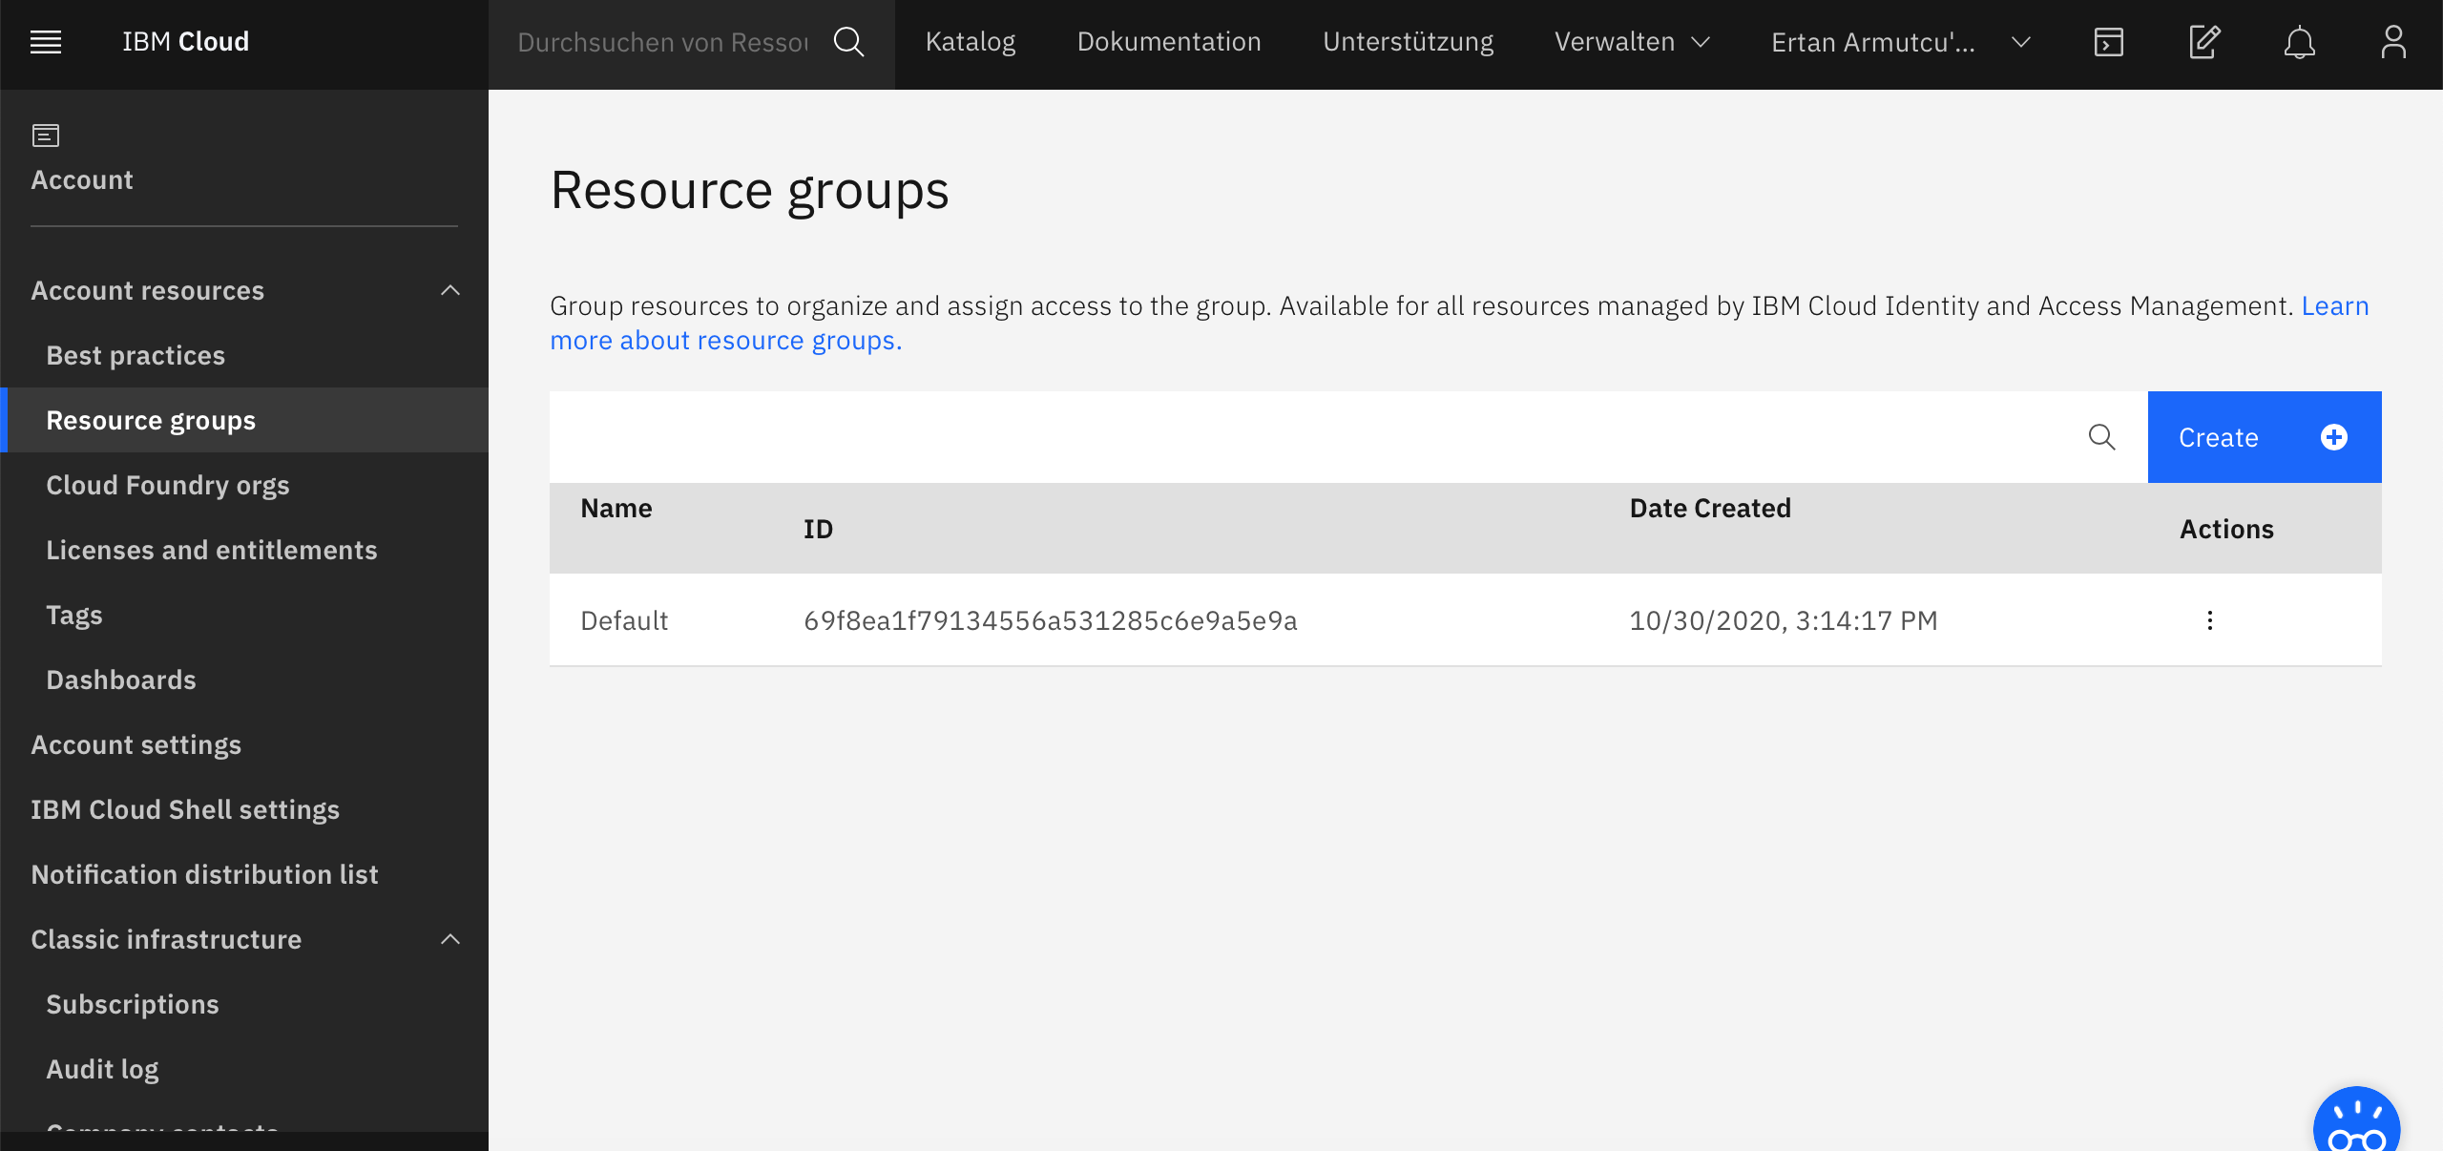
IBM Cloud Account Preferecnes
Click on „Resource groups“ and rename it to whatever you want since on default the name is your Email adress. Note: if you‘re on the lite plan you can only have 1 resource group.

Slide 7
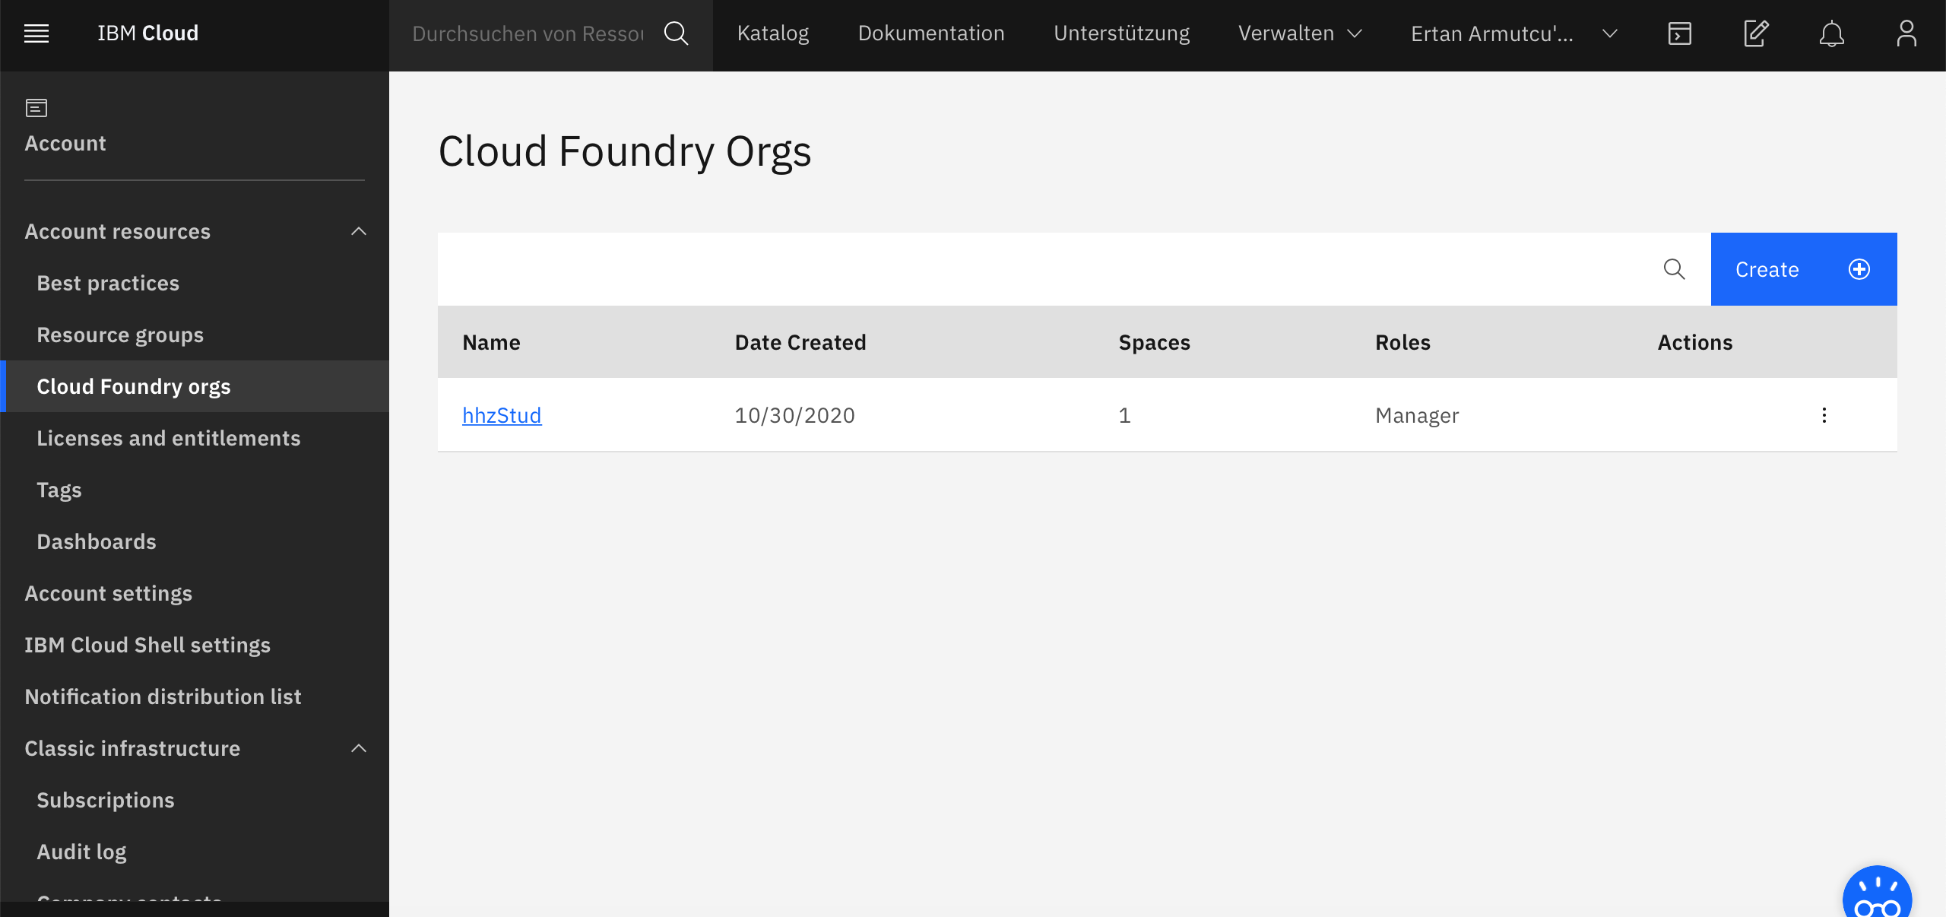
IBM Cloud Account Preferecnes
Click on „Cloud Foundry orgs“ and Create a new org by clicking the „Create“ button.

Slide 8
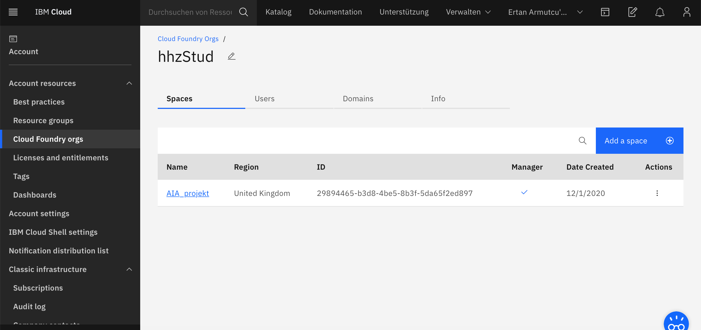
IBM Cloud Account Preferecnes
Next click on your created org and create a space within the org by clicking the „Add a space“ button. Name the space whatever you want.

Slide 9
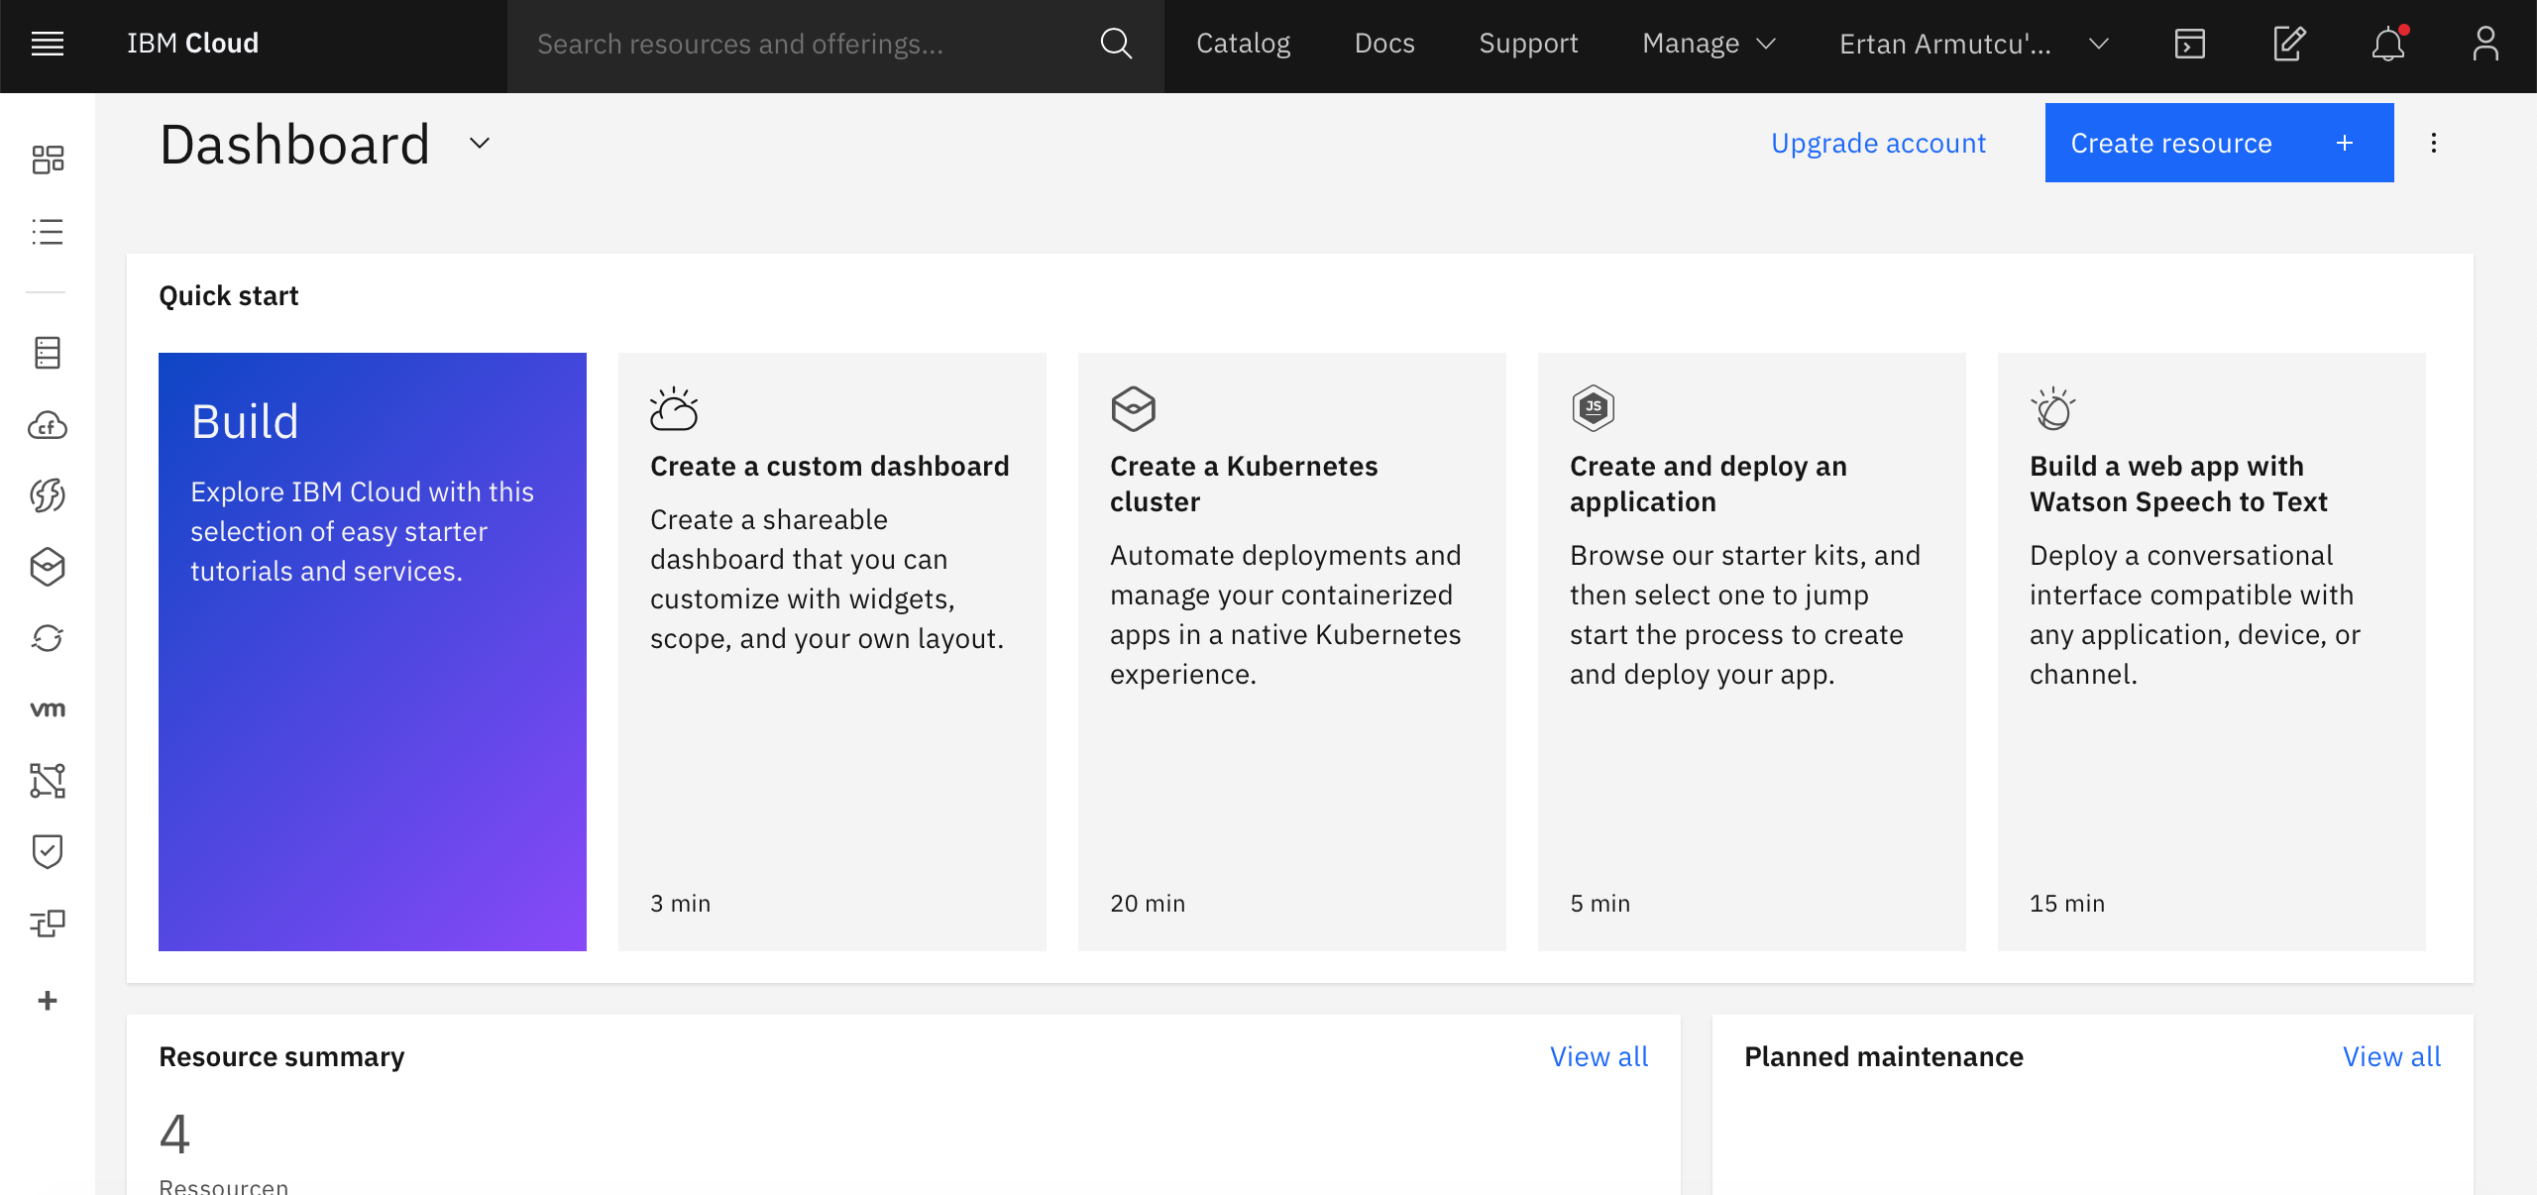
Create Watson Assistant
Open your IBM Cloud Dashboard (https://cloud.ibm.com)
Click on “Create resource“ to create an Watson Assistant service

Slide 10
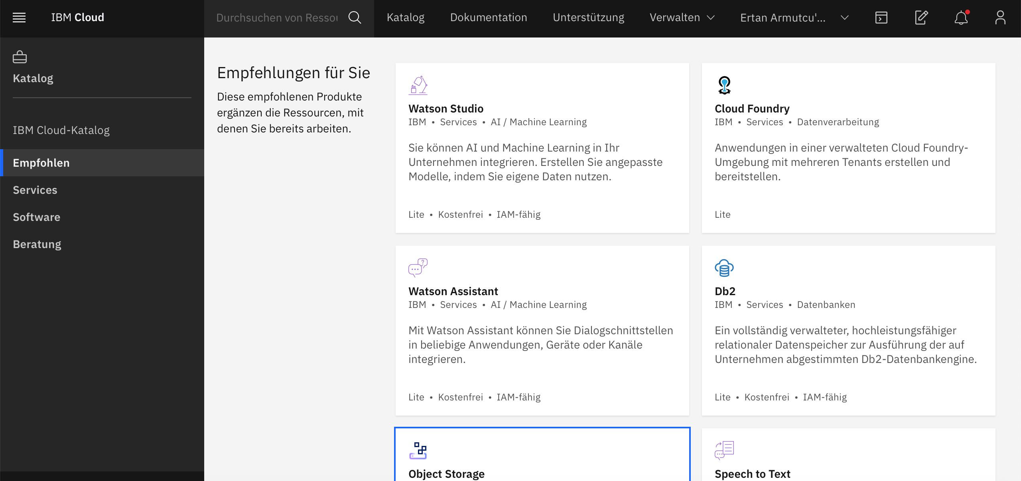
Create Watson Assistant
Click on Watson Assistant

Slide 11
Create Watson Assistant
Choose your region. If you are in Germany choose „London“ as region. The reason will be explained later in the Cloud Function section
Scroll down and give your Assistant a name
Select the resource group, which you renamed before and click on create. Note: You cant change the resource group once you created the assistant

Slide 12
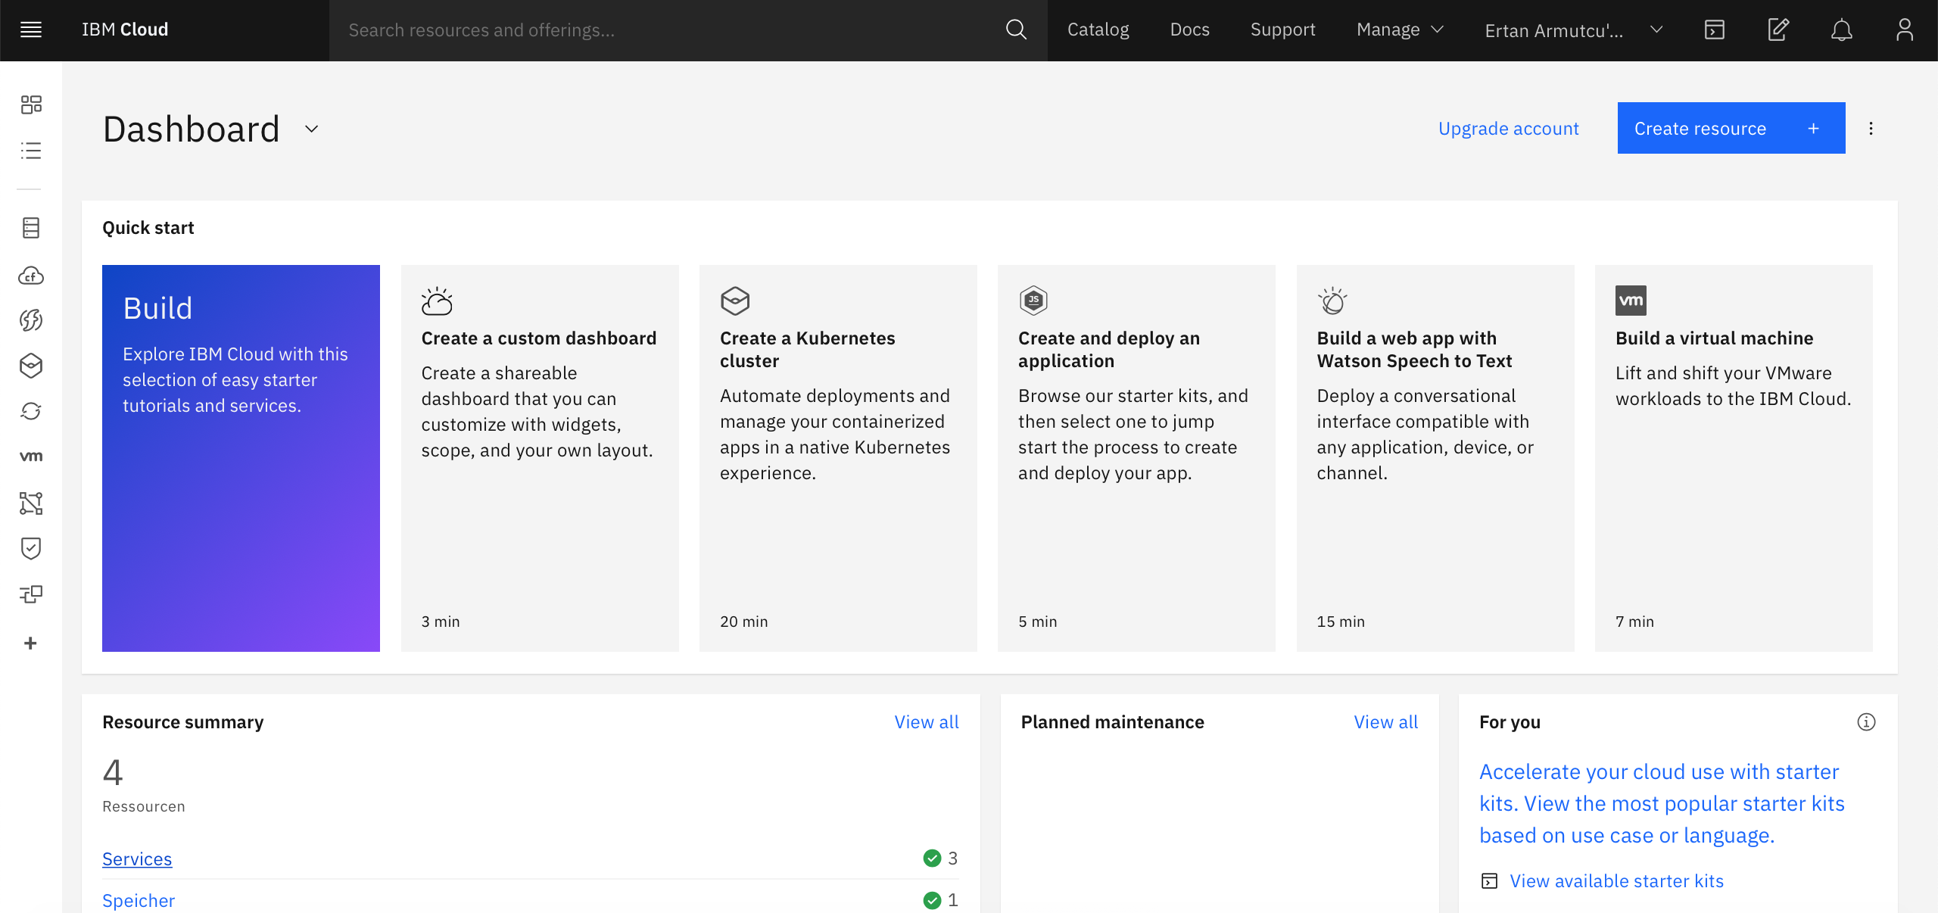
Create Watson Assistant
Go back to your IBM dashboard and click on „Services“. You should see your created Watson Assistant listed under „Services“. Click on your Assistant

Slide 13
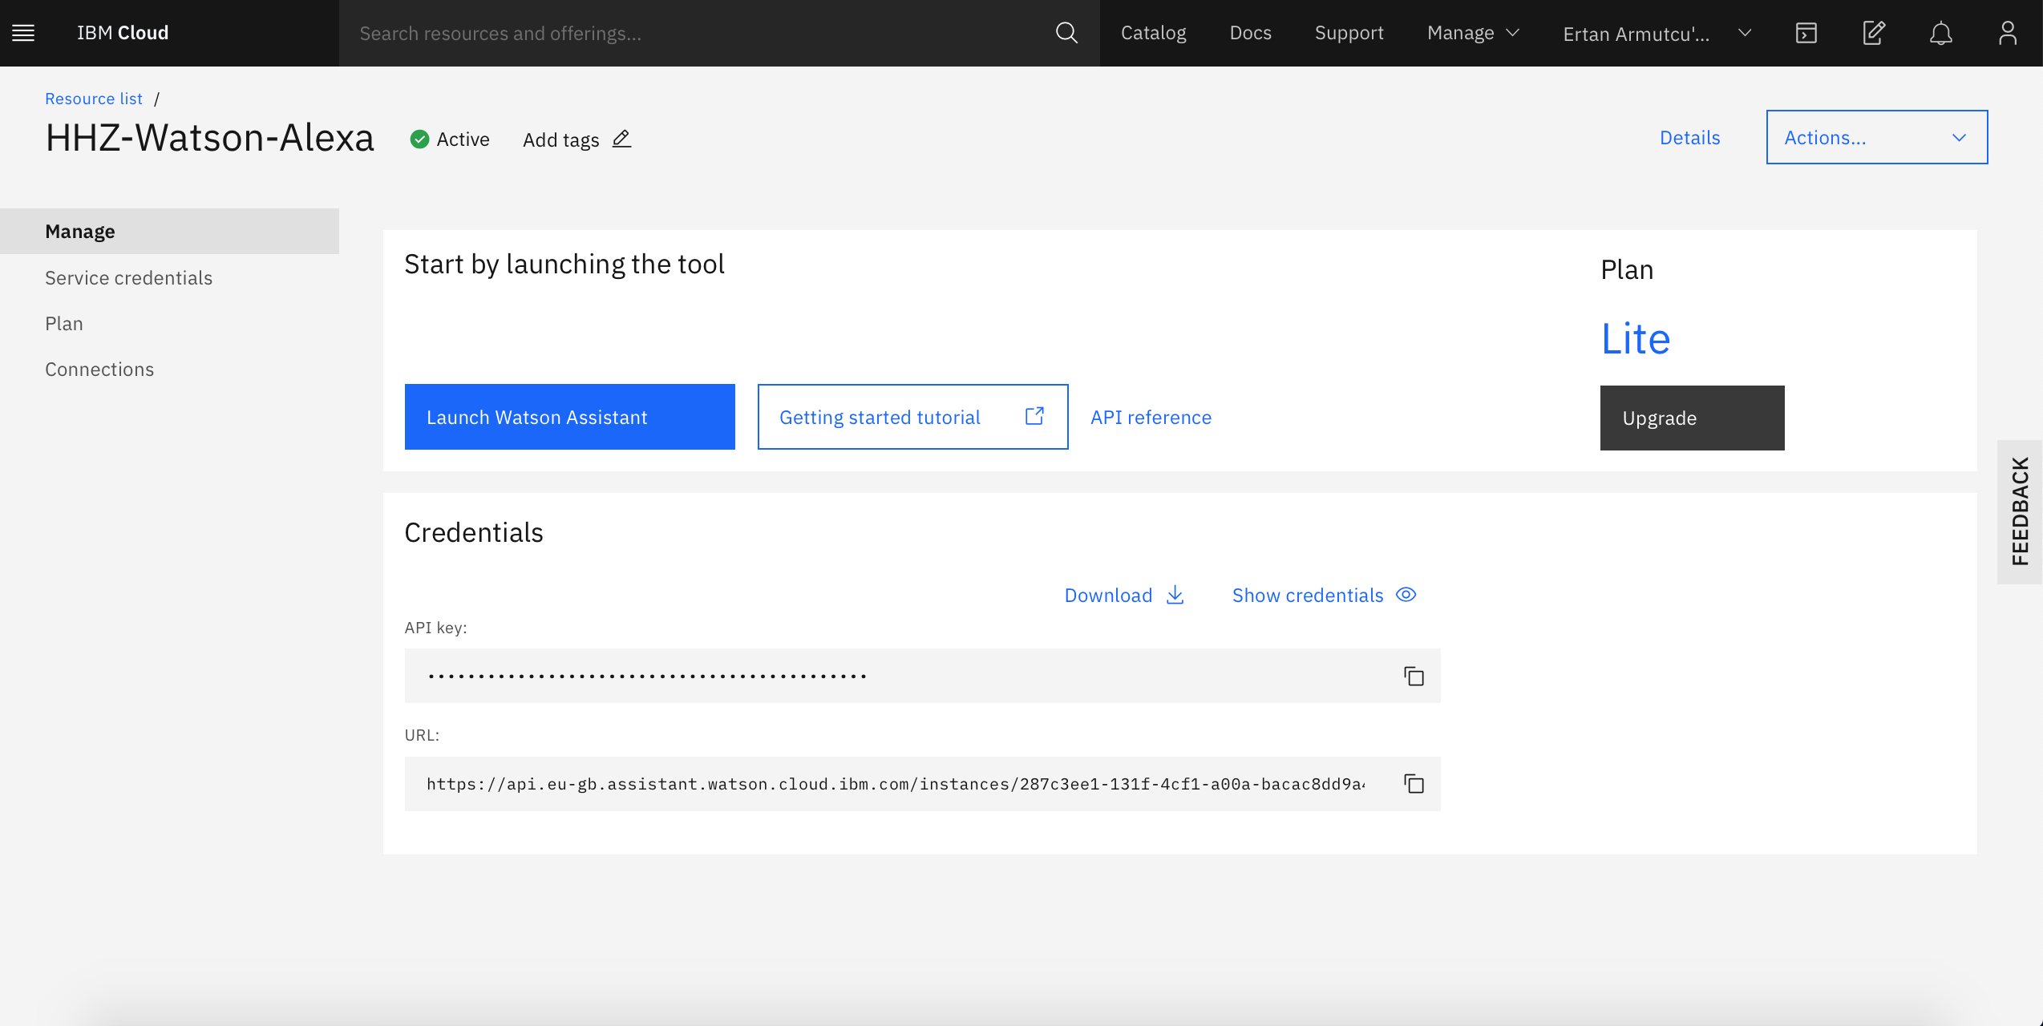
Create Watson Assistant
Before launching your Watson Assistant by clicking the „Launch Watson Assistant“ button copy your Credentials below and save them. You need it later

Slide 14
Create Watson Assistant
After launching your Assistant click on „Create Assistant“ and enter a name for your assistant. Afterwards click on „Create Assistant“
Now you should see your assistant instance on the page. Next step is to create a skill so click on your assistant.
Find the „Add dialog skill“ button and click on it
You can either create a skill from scratch or upload the example skill as json file. To upload the example skill use the tab „Import skill“. (Click here to download the json example skill)

Slide 15
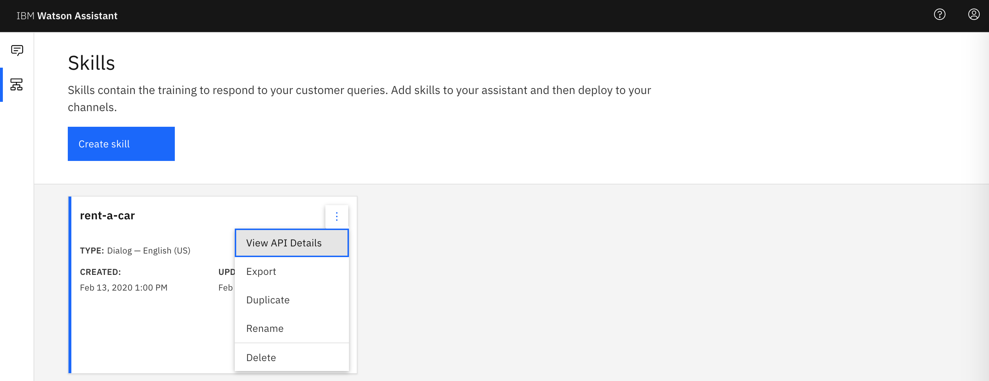
Create Watson Assistant
Go back to the „Skills“ tab on the left bar
Click on the three dot menu and choose „View API Details“
Copy your „Skill ID“ and save it where you stored your Credentials before. You will need all of them later

Slide 16
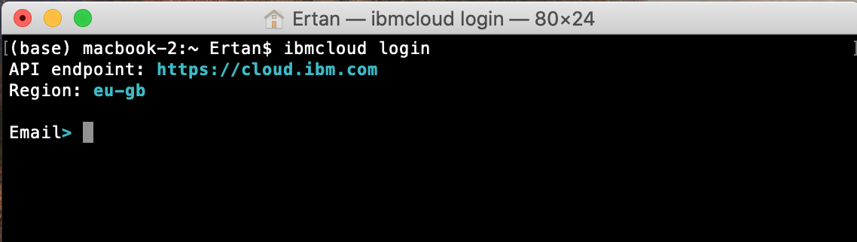
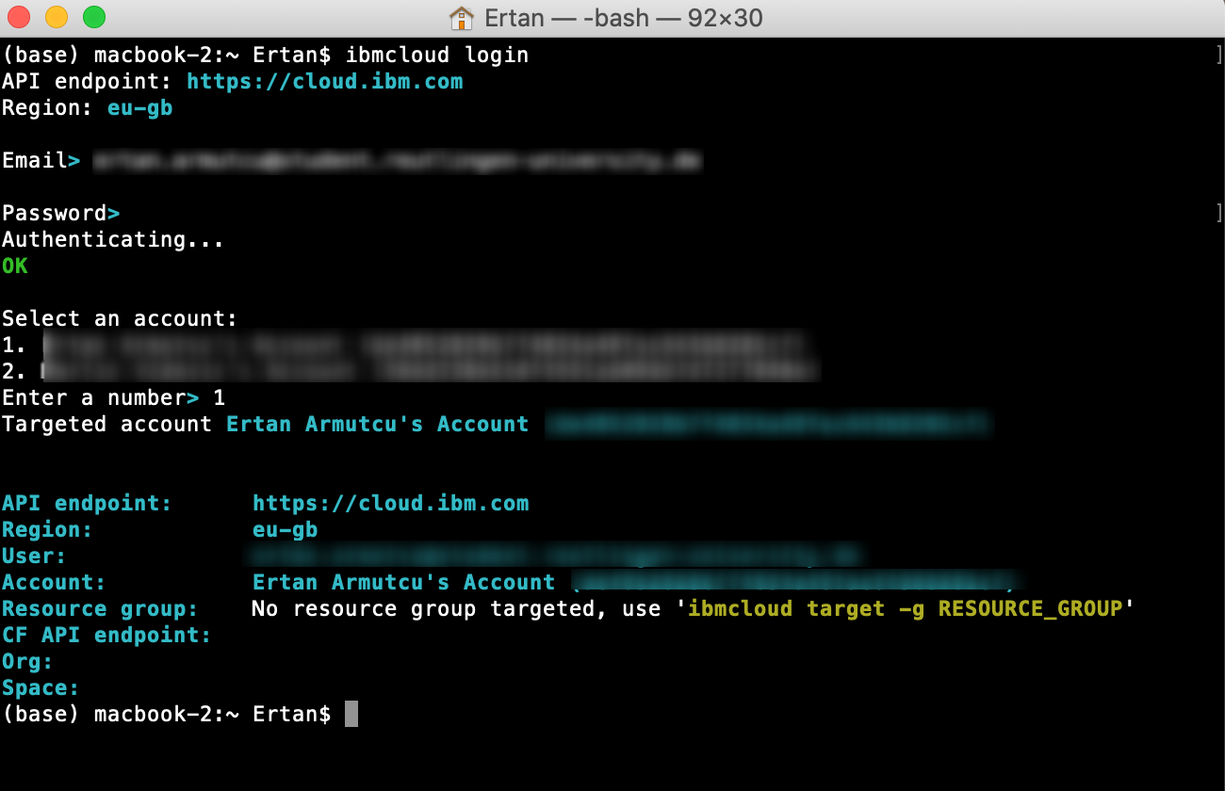
Cloud Functions: Installation and log in
2.
Download the cloud CLI release for your machine and run the installer (https://github.com/IBM-Cloud/ibm-cloud-cli-release/releases/)
Start a Terminal/Command Line Promt on your machine and run the command „ibmcloud login“
Enter your IBM Cloud Email and Password to log into your account
If you have more than one account select your account by entering a number.
Make sure you use the latest CLI version run the command „ibmcloud update“ to update if needed
ibmcloud login
ibmcloud update
Cloud Functions docs: https://cloud.ibm.com/docs/cli?topic=cli-install-ibmcloud-cli

Slide 17
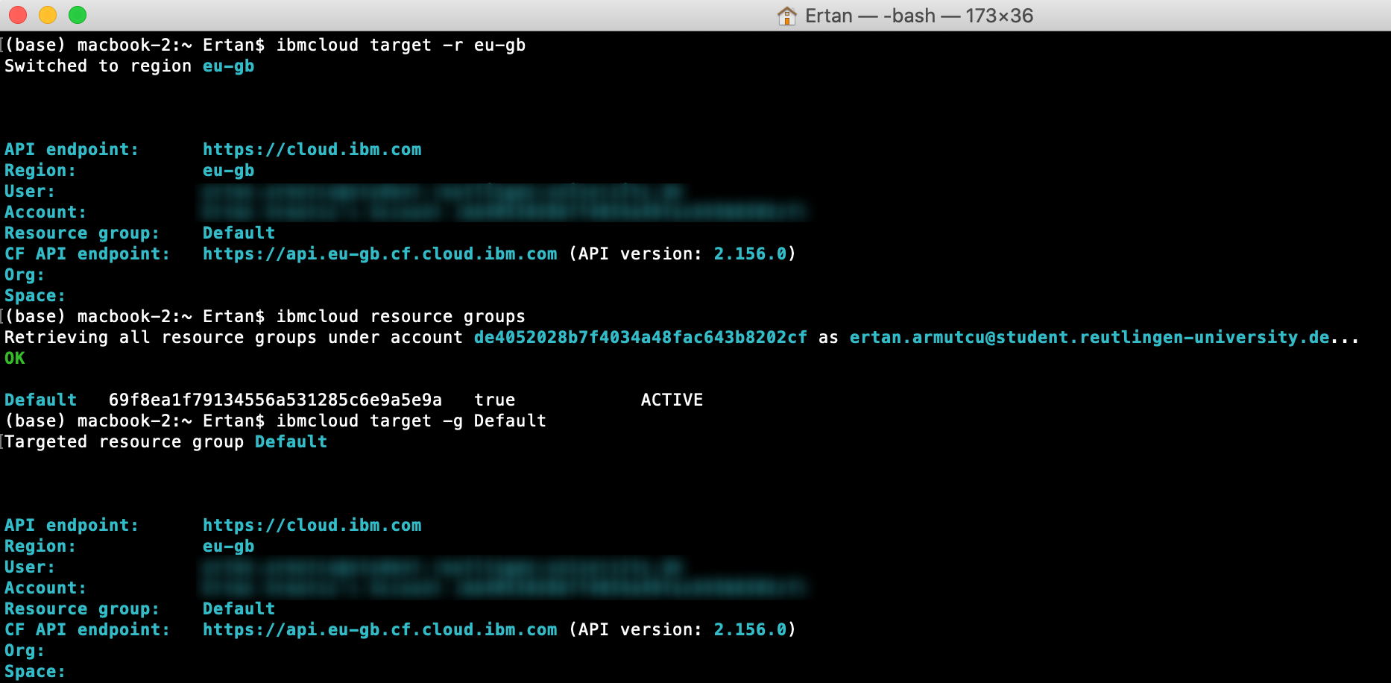
Cloud Functions : setting up region, organization and space
You must specify a region. Use the command „ibmcloud target -r eu-gb” to set your region. Somehow if your region is setted to Germany (eu-de) it is not possible to set your resource group. Therefore we switch to the region “eu-gb”.
Set your resource group by running the command
ibmcloud target -r eu-gb
target –g <your resource group>
Cloud Functions docs: https://cloud.ibm.com/docs/openwhisk?topic=openwhisk-cli_install

Slide 18
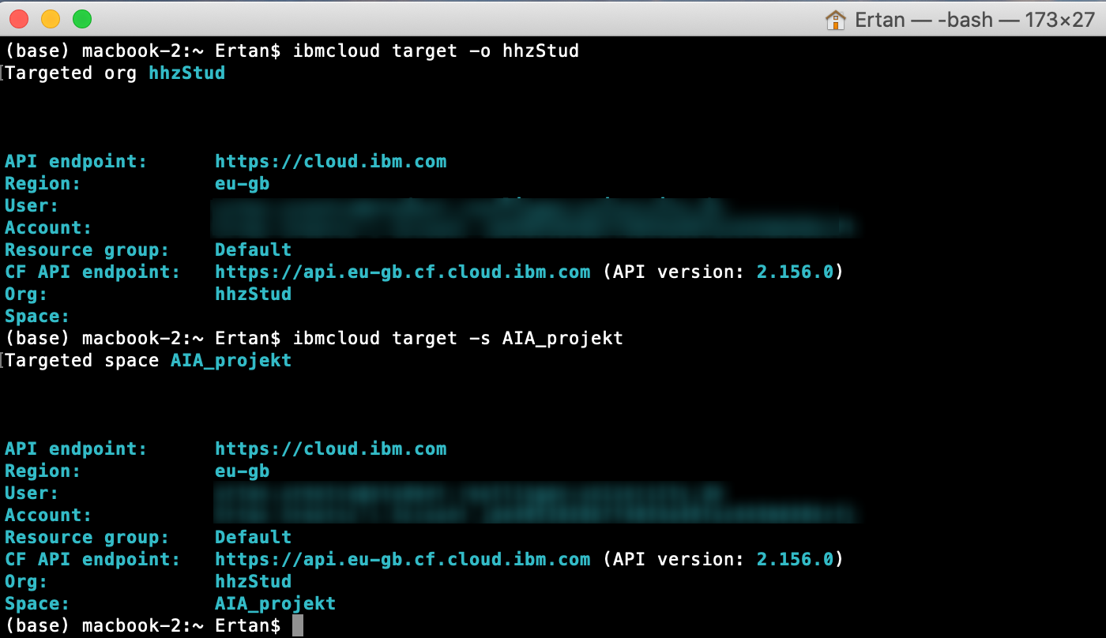
Cloud Functions : setting up region, organization and space
Next set your org by running following command: Note: use the org you set up before in the IBM Cloud Account Preferences section
Finally set your space by running Again use the space you created before
target –o <your org>
target -s <your space>”.
Cloud Functions docs: https://cloud.ibm.com/docs/openwhisk?topic=openwhisk-cli_install

Slide 19
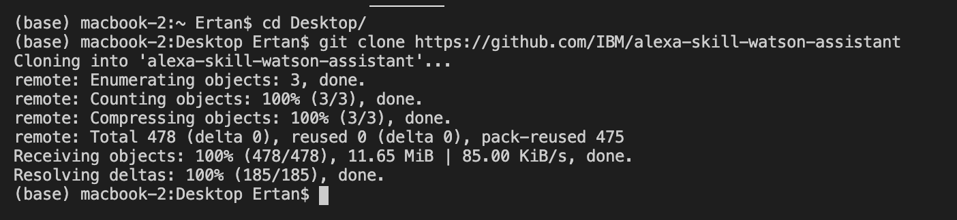
Open Whisk Action: Install Alexa-Watson repo
For the next step we need the Alexa Watson repo from Github.
Open a new Terminal/Command line prompt and change to the directory you want to install the repo. In my case I first used the command „cd Desktop“ to change to my Desktop before downloading the the repo.
run following command to download the repo:
cd Desktop
git clone https://github.com/IBM/alexa-skill-watson-assistant
Link to original repo: https://github.com/IBM/alexa-skill-watson-assistant
Link to original repo: https://github.com/IBM/alexa-skill-watson-assistant

Slide 20
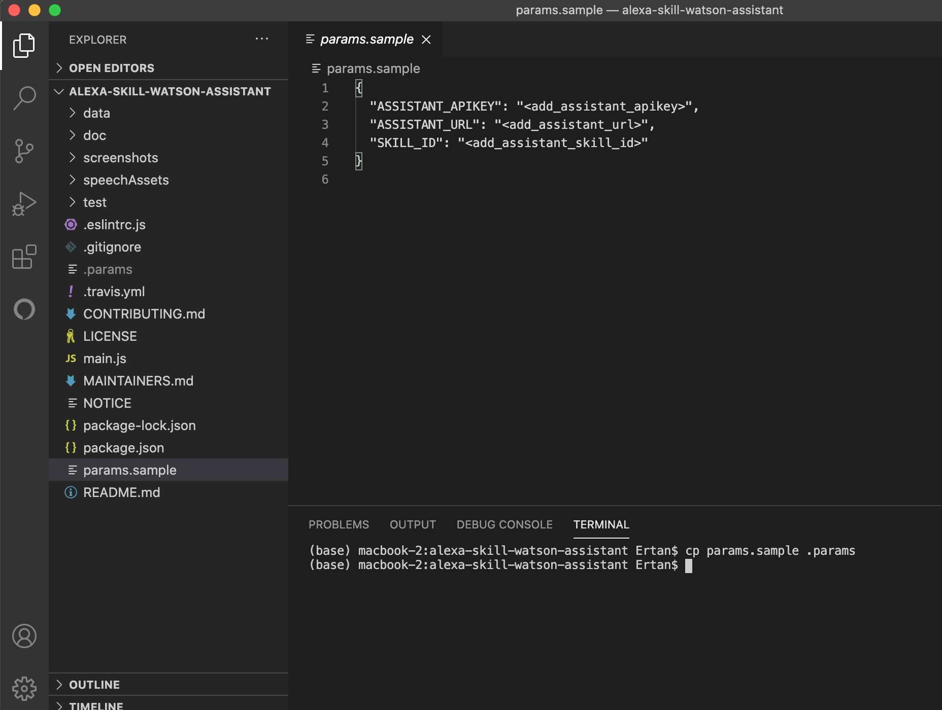
Open Whisk Action: Configure Credentials
For the next step we need the Alexa Watson repo from Github.
Open the repo in Visual Studio Code or any other editor. Copy the params.sampl to .params. by running following command:
Edit the .params file and paste your Credentials
params.sample
.params
cp params.sample .params
.params
Link to original repo: https://github.com/IBM/alexa-skill-watson-assistant

Slide 21
Open Whisk Action: Create Action
Before we create the action we need to gather the requirements for Node.js by running following commands: 1.
Note: npm is a package manager for the JavaScript runtime environment Node.js. If you haven’t installed npm please install it first.
2.
Note: this command removes the action.zip file in the directory if there is any. If not skip this command
npm install
rm action.zip
Link to original repo: https://github.com/IBM/alexa-skill-watson-assistant

Slide 22
Open Whisk Action: Create Action
3. Note: this command zips your main.js file and the installed node_modules. 4. Note: this command updates the action named „alexa-watson“ with the current created „action.zip“ file. If there is no action named like this it will create a new action. Furthermore, the following additional parameters are passed: : the runtime version of node.js : enabling HTTP web action, which allows your Cloud Functions actions to handle HTTP events. When enabled your Action receives requests in plain text instead of a JSON body : our Watson assistant crendentials
zip -r action.zip main.js package* node_modules
ibmcloud wsk action update alexa-watson action.zip --kind nodejs:default --web raw --param-file .params
--kind node.js: default
--web raw
--param-file .params
Link to original repo: https://github.com/IBM/alexa-skill-watson-assistant

Slide 23
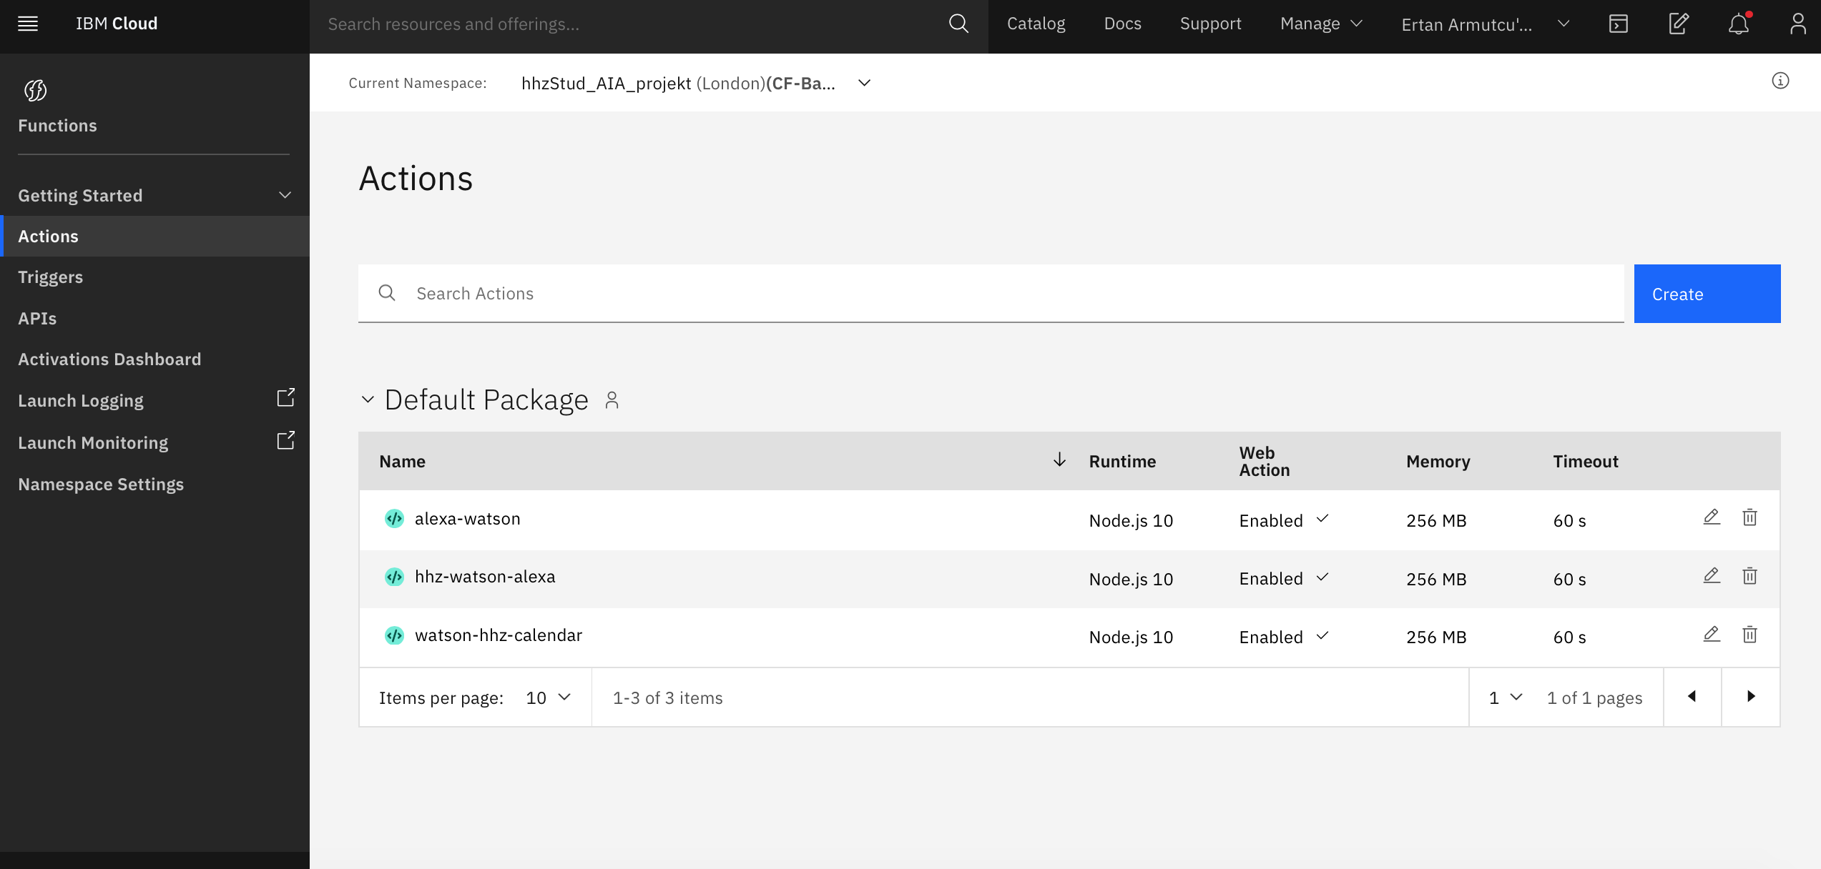
Open Whisk Action: Check your action
Navigate to https://cloud.ibm.com/functions/actions to check your actions. You should see your uploaded action listed in here.
Click on your action
Note: As you can see it is also possible to create actions from this page. But it is not possible to install dependencies through this method. Therefore we setted up everything locally and uploaded a .zip file which contains all the required dependencies.
Link to original repo: https://github.com/IBM/alexa-skill-watson-assistant

Slide 24
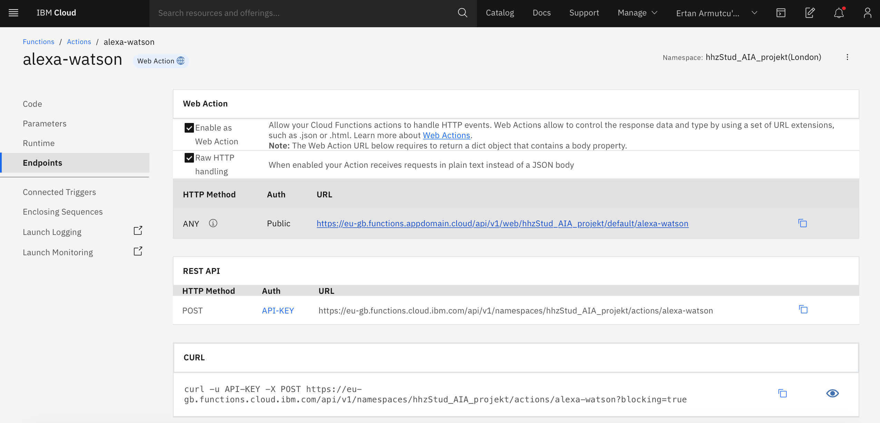
Open Whisk Action: Get Endpoint URL
After click on your action click on „Endpoints“ in the left side bar
Copy and save the HTTP Method URL. You will need in to connect your Alexa Skill with your Watson Assistant later
Link to original repo: https://github.com/IBM/alexa-skill-watson-assistant

Slide 25
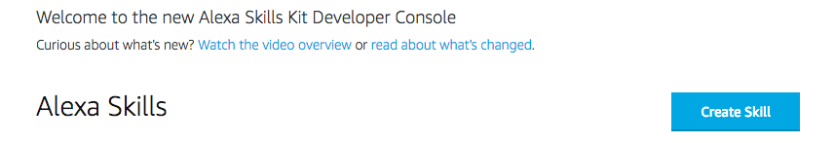
Alexa Skill: Sign up and create Skill
Sign up for an Amazon Developer Portal account here.
Go to https://developer.amazon.com/alexa/console/ask and click the Create Skill button.
Source: https://github.com/IBM/alexa-skill-watson-assistant

Slide 26
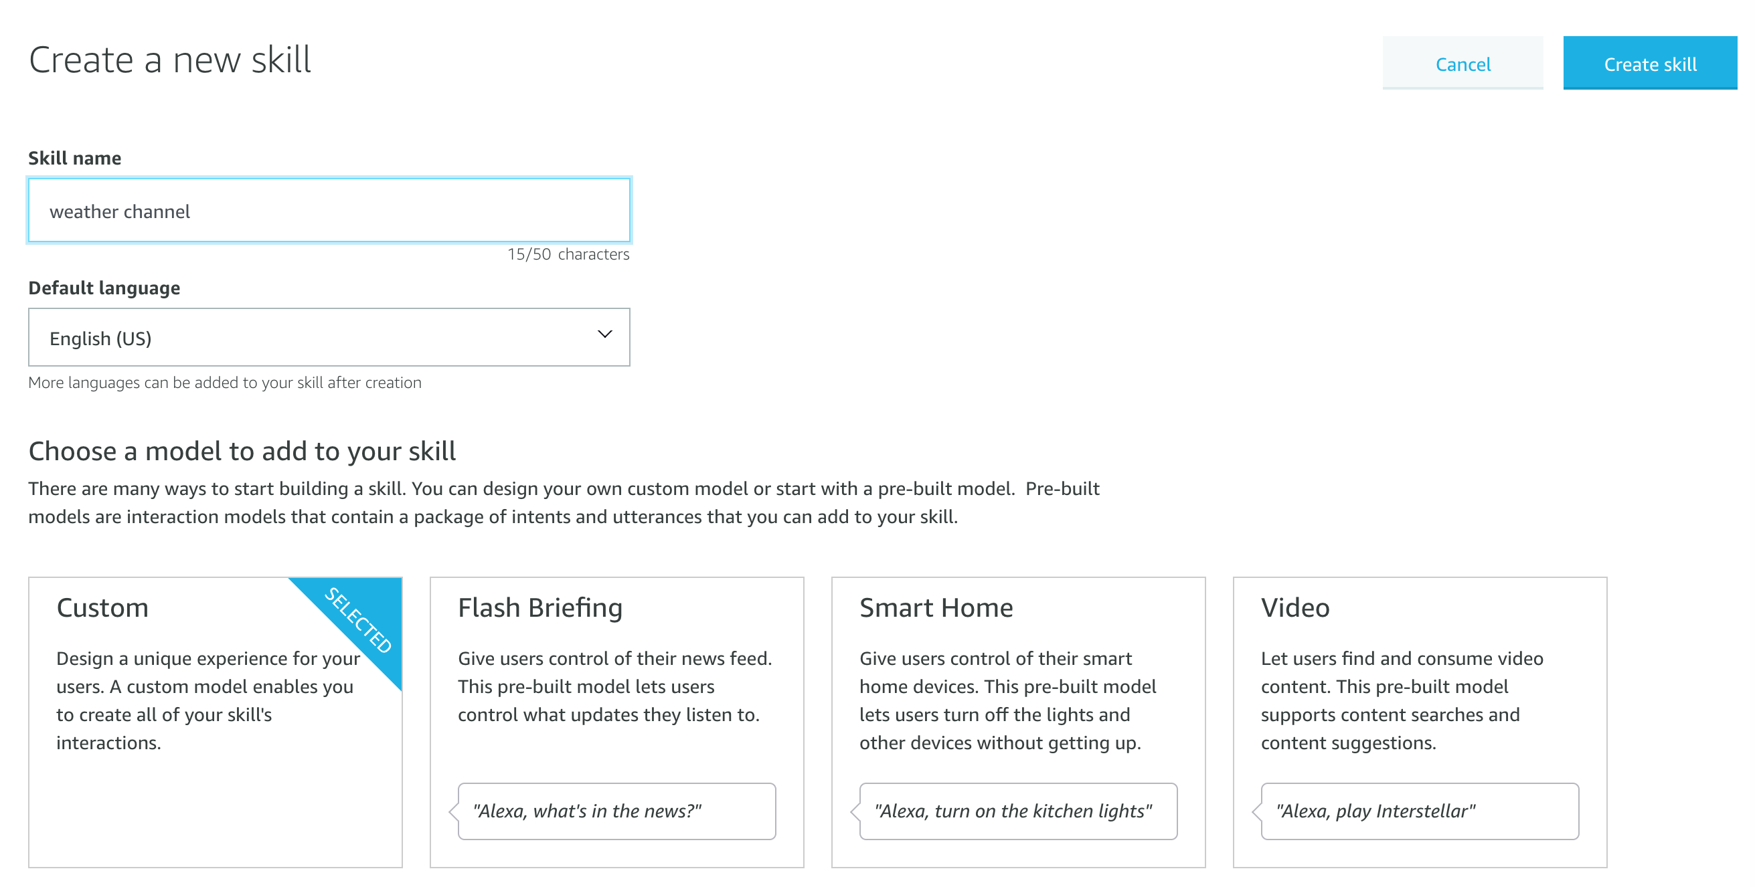
Alexa Skill: Create Skill
Provide a name, choose Custom model and hit the Create skill button.
Source: https://github.com/IBM/alexa-skill-watson-assistant

Slide 27
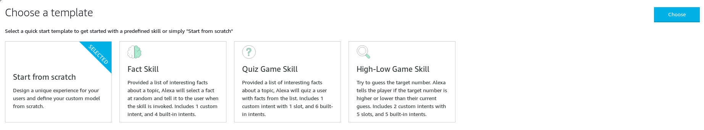
Alexa Skill: Create Skill
Select the Start from scratch template and hit the Choose button.
Source: https://github.com/IBM/alexa-skill-watson-assistant

Slide 28
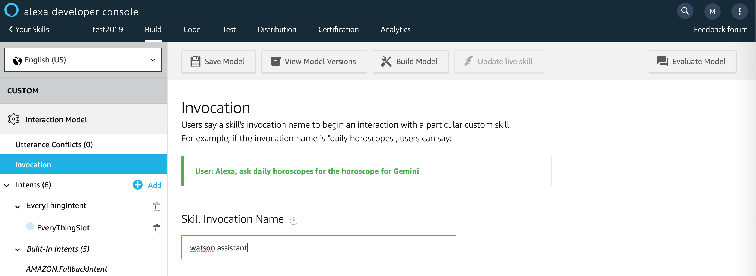
Alexa Skill: Invocation name
Provide an invocation name:
Source: https://github.com/IBM/alexa-skill-watson-assistant

Slide 29

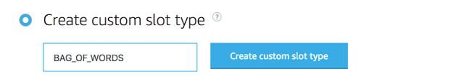
Alexa Skill: Custom Slot type
Add a custom slot type: - In the left sidebar menu, click on Slot Types (#) and hit + Add - Use the name BAG_OF_WORDS and hit the Create custom slot type button
Source: https://github.com/IBM/alexa-skill-watson-assistant

Slide 30
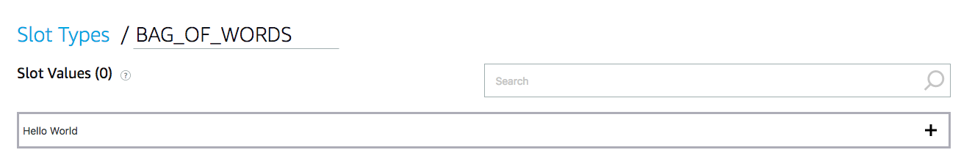
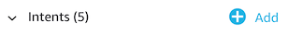
Alexa Skill: Slot value & Intent type
- Now BAG_OF_WORDS needs a slot value. Just enter Hello World and hit the plus sign so that it has a slot value.
Add a custom intent type: - In the left sidebar menu, click on Intents (#) and hit + Add.
Source: https://github.com/IBM/alexa-skill-watson-assistant

Slide 31
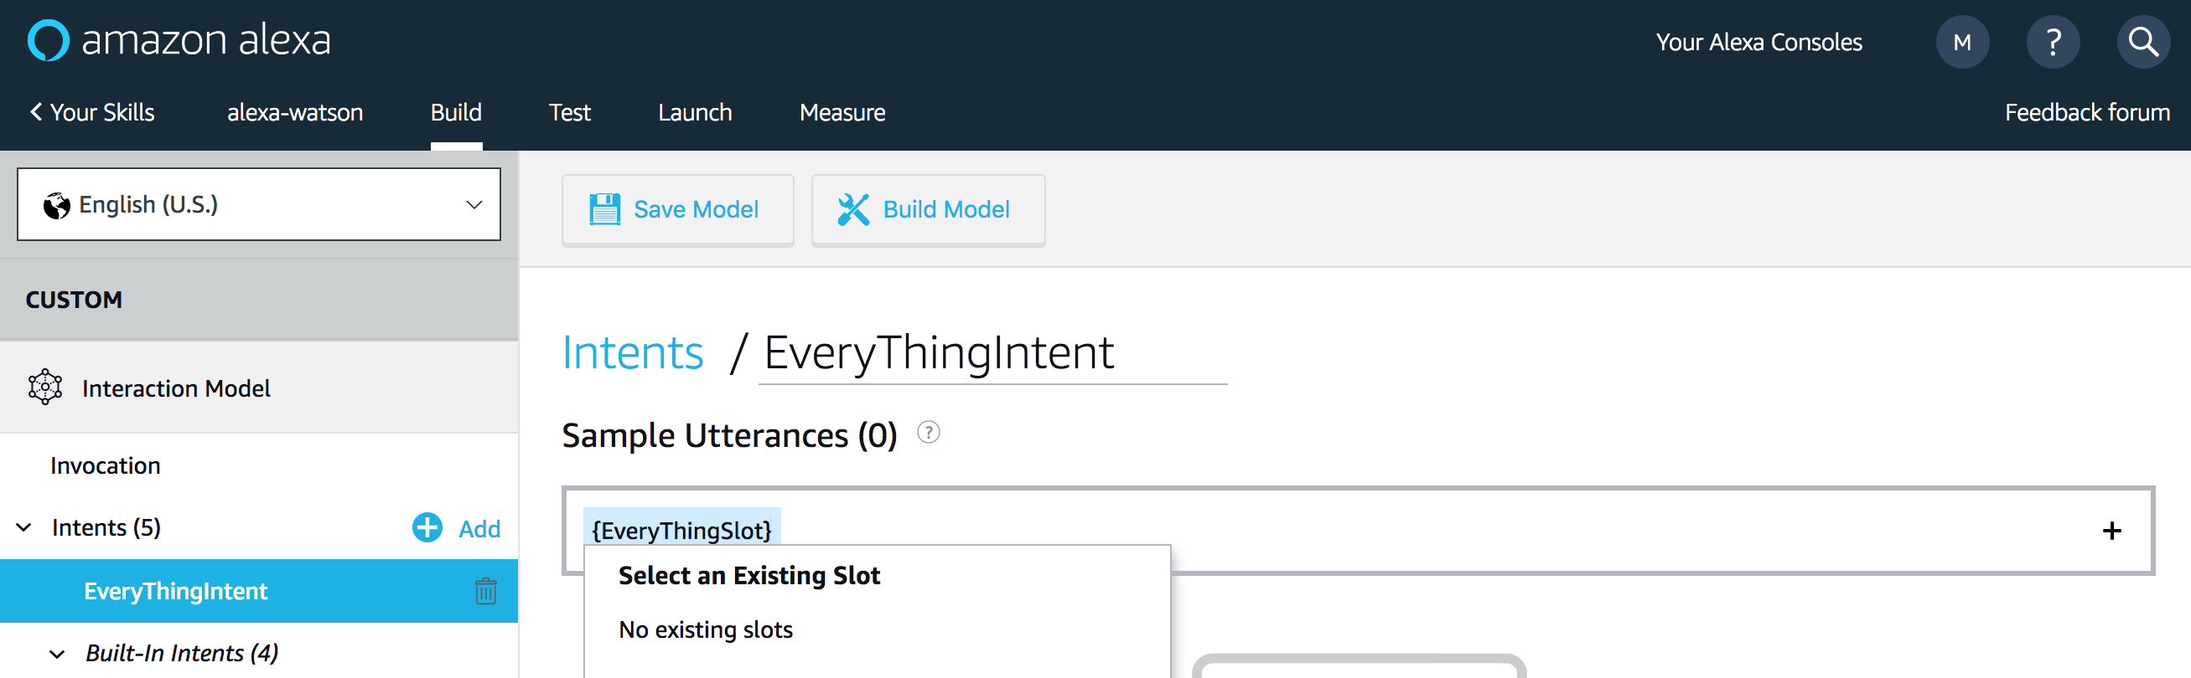
Alexa Skill: Intent Utterances
- Use the name EveryThingIntent and hit the Create custom intent button.
- Add {EveryThingSlot} under Sample Utterances. Use the plus sign to create the EveryThingSlot.
Source: https://github.com/IBM/alexa-skill-watson-assistant

Slide 32
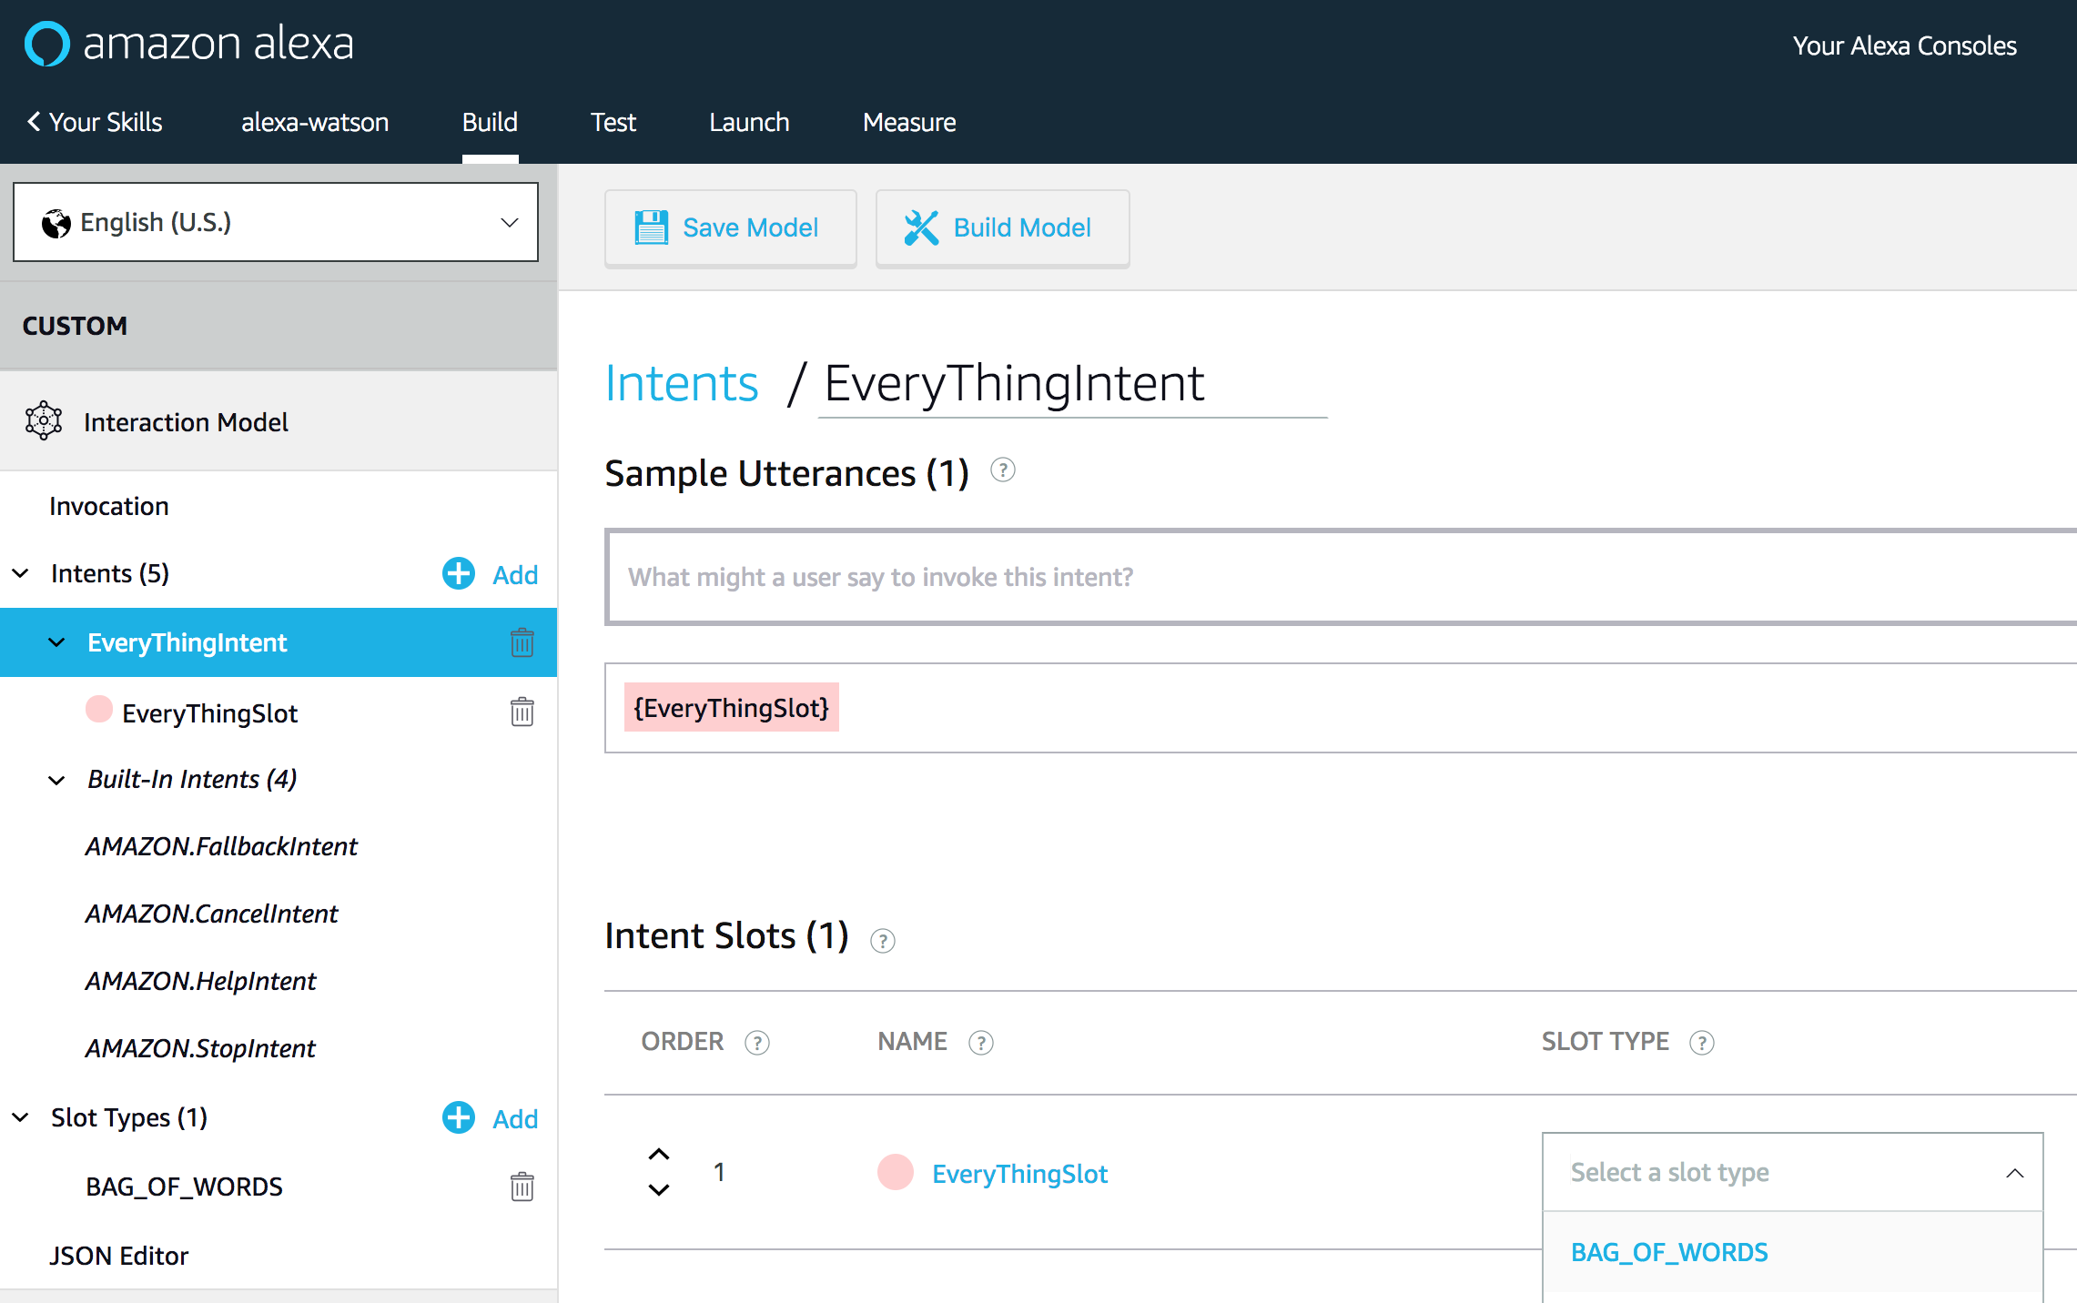
Alexa Skill: Intent Slots
- Scroll down to Intent Slots (#)
- Use the Select a slot type pulldown to give EveryThingSlot the slot type BAG_OF_WORDS.
- Click on Save Model and then Build Model.
Source: https://github.com/IBM/alexa-skill-watson-assistant

Slide 33
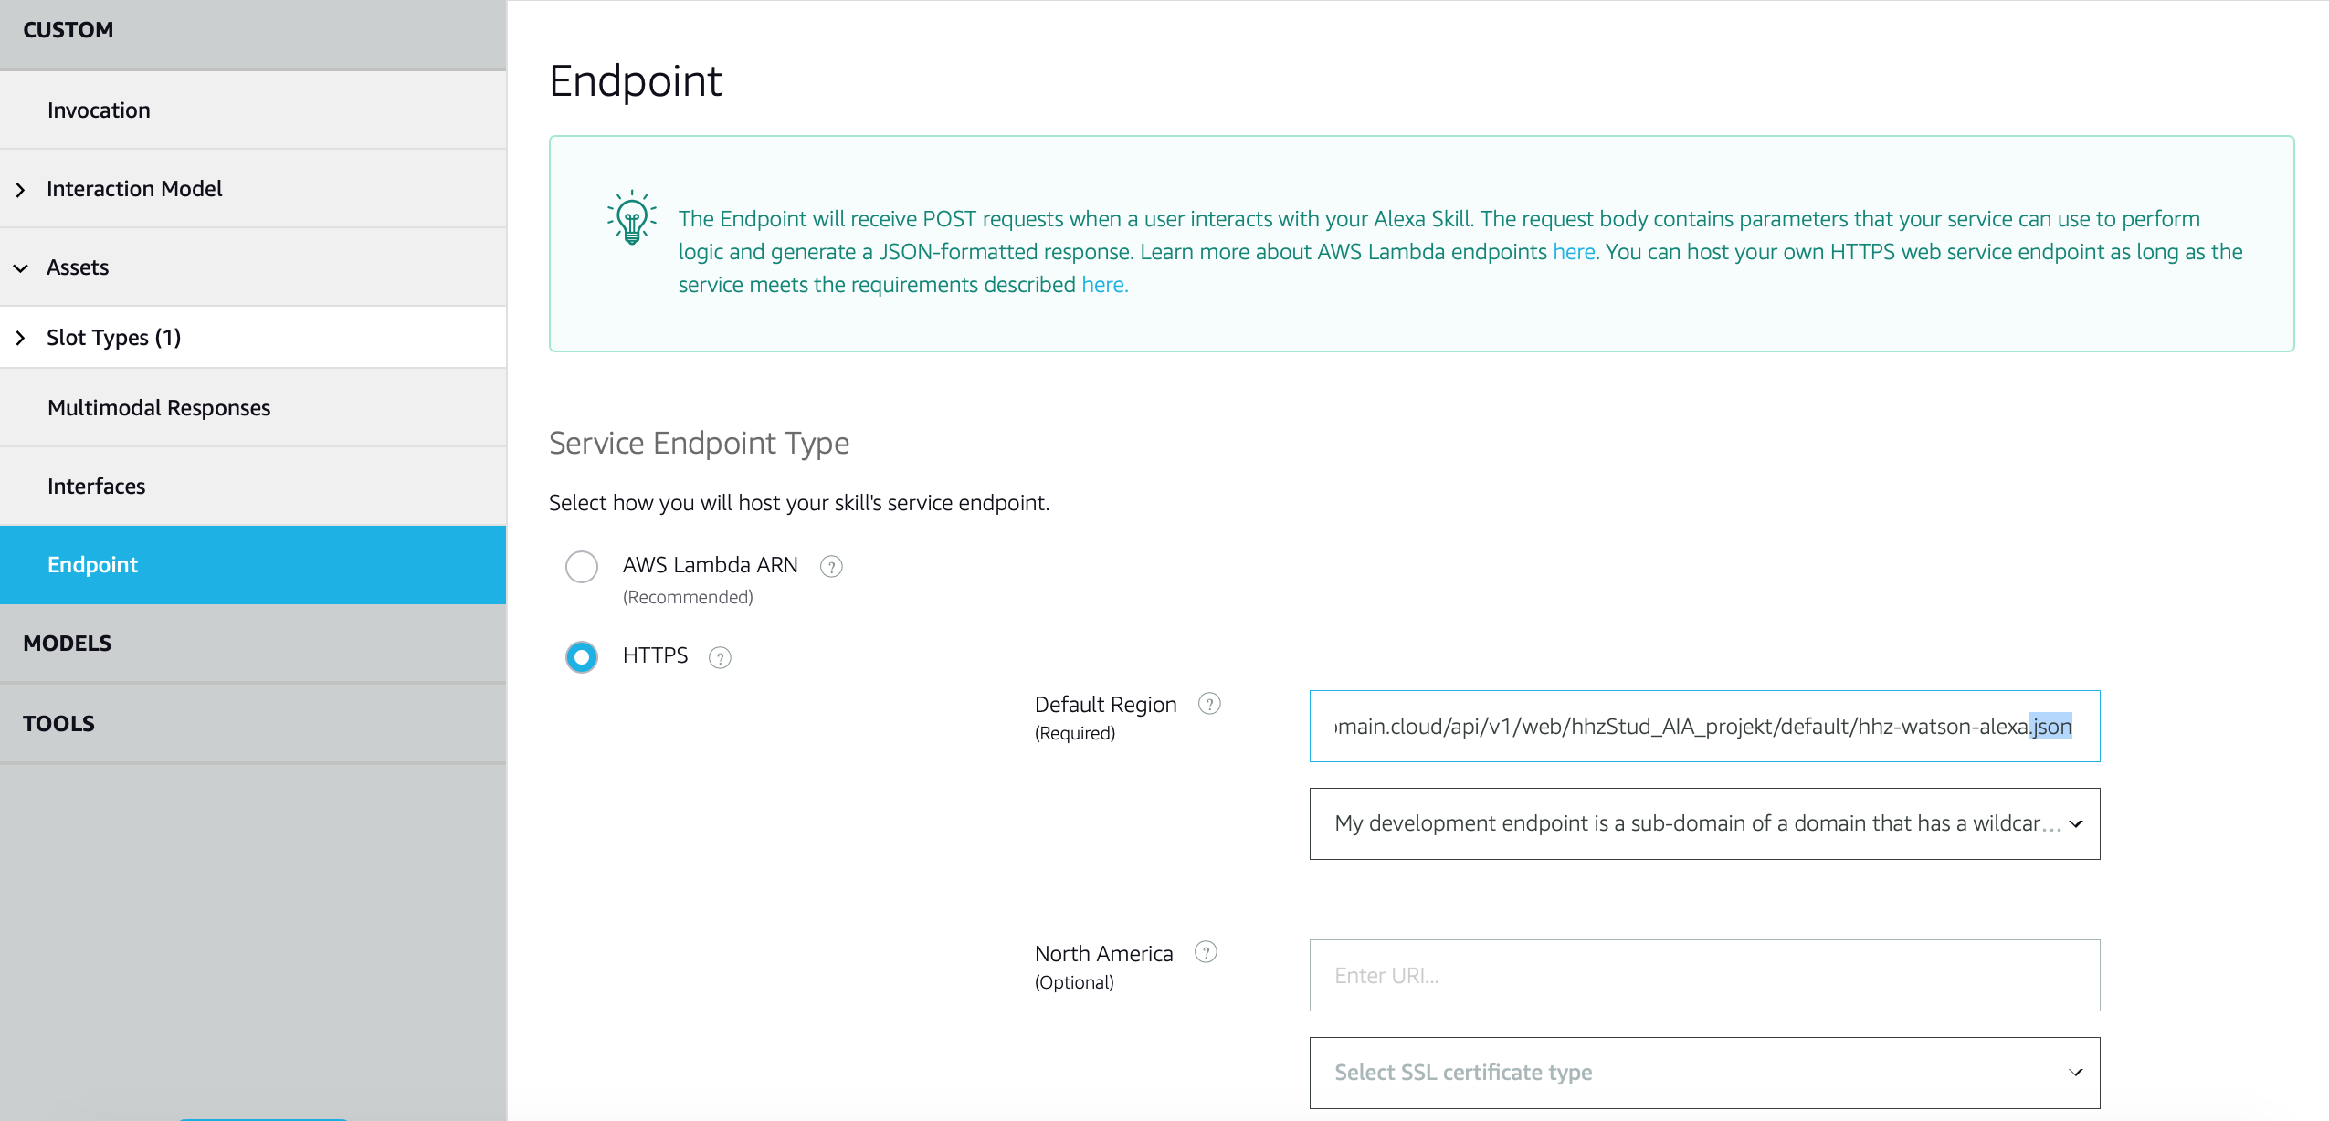
Alexa Skill: Endpoint Configuration
Configure the endpoint: -Click on Endpoint in the sidebar. -Select HTTPS as the Service Endpoint Type. -For the Default Region enter the HTTPS service endpoint which is the URL of your OpenWhisk Web Action. -Add a .json suffix to your service endpoint url (IMPORTANT!)
Source: https://github.com/IBM/alexa-skill-watson-assistant

Slide 34
Alexa Skill: Completed Skill
- Use the pull-down to select My development endpoint is a sub-domain of a domain that has a wildcard certificate from a certificate authority. - Click the Save Endpoints button!
DONE!!
Source: https://github.com/IBM/alexa-skill-watson-assistant

Slide 35
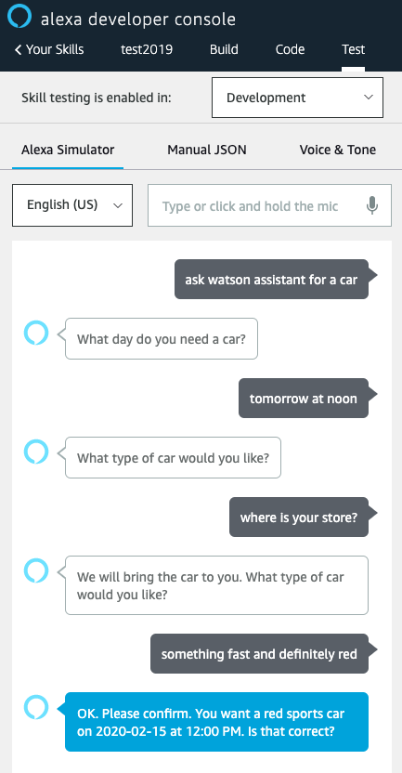
Alexa Skill : Test the Skill
Use the Test tab in the Amazon developer console.
Use the drop-down to enable your skill for testing in Development. You can type or talk and test the skill in the test UI.
Source: https://github.com/IBM/alexa-skill-watson-assistant

Slide 36
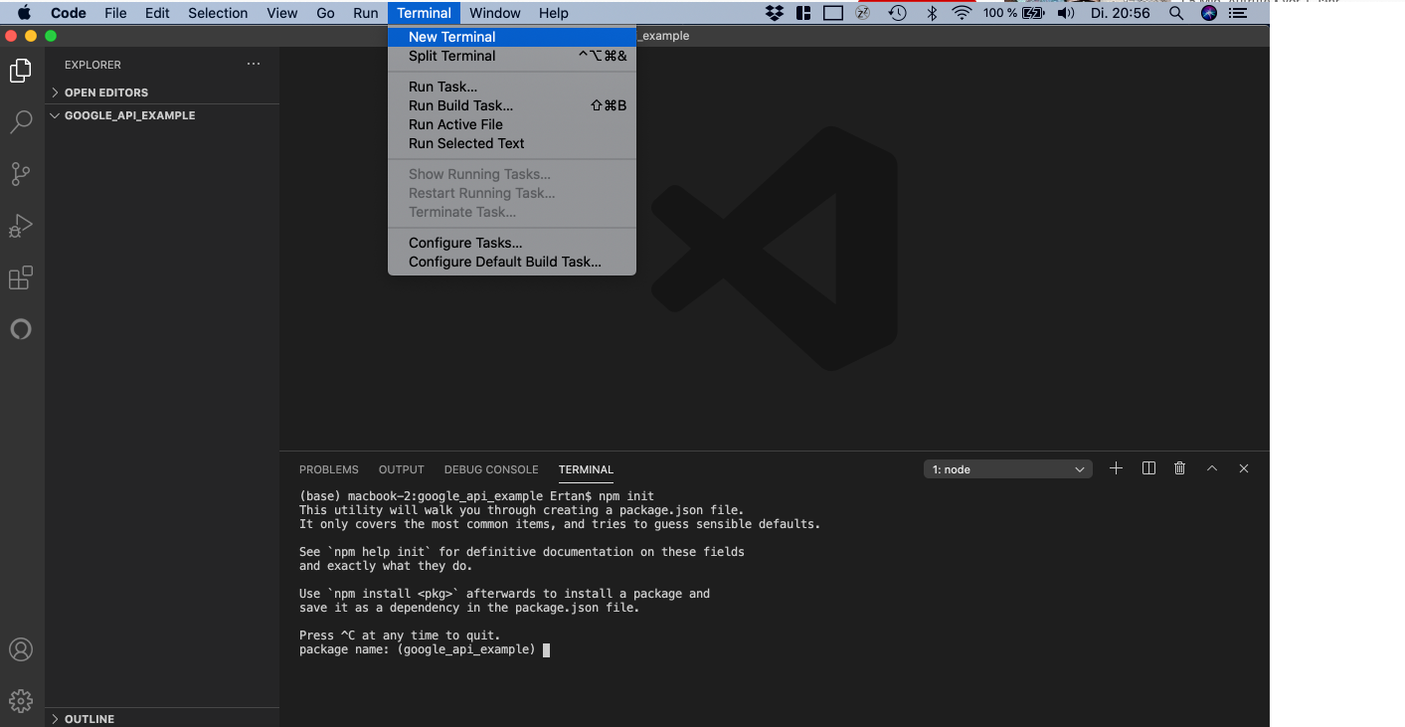
Access public Google Calendar : Project Setup
To answer questions like „When will lecture XY take place“ our Watson Assistant need read access to the events of the public calendar of HHZ. In this section we set up the API to access the public calendar
Create a new folder on your computer and open it in Visual Studio Code. Open a new Terminal from the „Terminal“ tab on the top in Visual Studio Code. Run the following command to create a project
npm init

Slide 37
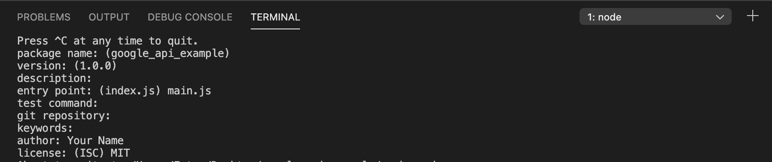
Access public Google Calendar : Project Setup
Hit enter, since we dont want to specify a package name.
Again hit enter for the version properpy without typing in everything
Hit enter again for the description.
For the entry point type in
Hit enter until the property and type in your name
For license type in
Hit enter and confirm with
main.js
author
MIT
yes

Slide 38
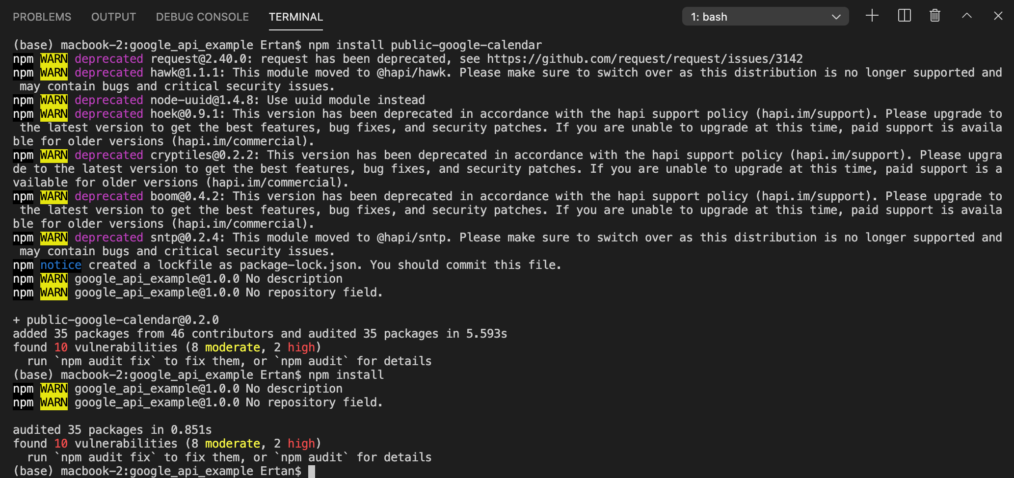
Access public Google Calendar : Install required packages
Next we need to install our required packages.
First run the command to install the public-google-calendar API
Next run the command to install the Node.js dependecies
npm install public-google-calendar
npm install

Slide 39
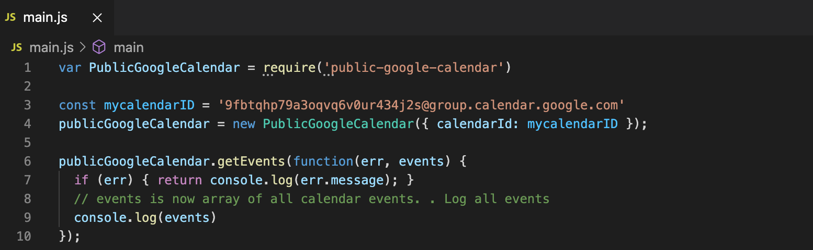
Access public Google Calendar : Create main.js, paste code and insert calendar ID
Create a new file and name it „main.js“
Copy the example code on the right and paste it in your „main.js“ file
Get the calendar ID of your public calender and paste it as value of
Note: You can get the calendar ID from the URL of the public calendar
Your main.js file should look the main.js file on the right
//Example Code:
var PublicGoogleCalendar = require('public-google-calendar')
const mycalendarID = 'paste your calID here‘
publicGoogleCalendar = new PublicGoogleCalendar({ calendarId: mycalendarID });
publicGoogleCalendar.getEvents(function(err, events) {
if (err) { return console.log(err.message); }
// events is now array of all calendar events. Log all events
console.log(events)
});
mycalendarID
Link to orginal repo: https://github.com/Espesen/public-google-calendar

Slide 40
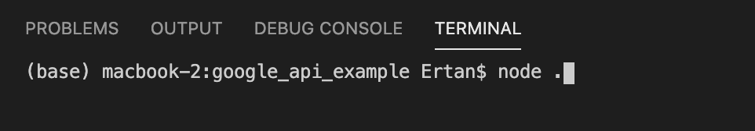
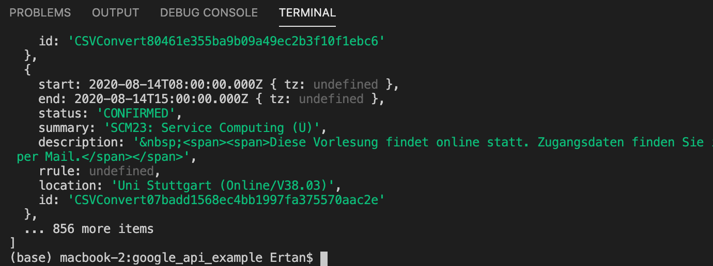
Access public Google Calendar : Test your code
Test your code by running
As you can see we got an array with more than 856 calender events
Input:
node .
Output:
Link to orginal repo: https://github.com/Espesen/public-google-calendar

Slide 41
Access public Google Calendar : Adjust code for OpenWhisk Action
Replace the current code in „main.js“ with the adjusted code on the right
Note: To run our code in the cloud functions we need to add a main-function. The main-function will be called in the cloud. Therefore is important otherwise the code will not run in the cloud.
When the main function executes a Promise will be returned. Next will be executed. After this function finishes it will callback the function . This function will either resolve or reject the promise. When the promise is resolved will be returned as response. Otherwise an error will be logged.
The main function will return the propery of the first element in the list to our Watson Assistant
const util = require('util');
var PublicGoogleCalendar = require('public-google-calendar');
const mycalendarID = '9fbtqhp79a3oqvq6v0ur434j2s@group.calendar.google.com'
const publicGoogleCalendar = new PublicGoogleCalendar({ calendarId: mycalendarID });
function main(params) {
return new Promise((resolve, reject) => {
publicGoogleCalendar.getEvents((err, events) => {
if (err) {
reject(err);
}
// events is now array of all calendar events.
resolve(events);
});
})
.then(events => {
console.log(events[0].summary);
return { message: events[0].summary }
})
.catch(err => {
console.log(err);
});
}
exports.main = main;
exports.main = main
publicGoogleCalendar.getEvents
(err,events)
{ message: events[0].summary }
Link to orginal repo: https://github.com/Espesen/public-google-calendar

Slide 42
Access public Google Calendar : Adjust code for OpenWhisk Action
Note:
Returning the propery summary of the first list value is only used to illustrate the function. It is also possible to process variables from Watson Assistant and adjust the output accordingly. Variables from Watson Assistant can be accesed through the params argument within the main function.
Next we need to upload this code as OpenWhisk action like we did for the alexa-skill connection before.
var PublicGoogleCalendar = require('public-google-calendar')
const mycalendarID = '9fbtqhp79a3oqvq6v0ur434j2s@group.calendar.google.com'
const publicGoogleCalendar = new PublicGoogleCalendar({ calendarId: mycalendarID });
let allEvents = [] //Object to store cal events
publicGoogleCalendar.getEvents( (err, events) =>{
//this function code will run after publicGoogleCalendar.getEvents finished. publicGoogleCalendar.getEvents callbacks function events with err and events.
if (err) {
return console.log(err.message);
}
// events is now array of all calendar events.
allEvents = events
main()
});
function main(params) {
if (Object.entries(allEvents).length > 0) {
console.log(allEvents[0].summary)
return { message: allEvents[0].summary };
}
}
exports.main = main;
Link to orginal repo: https://github.com/Espesen/public-google-calendar

Slide 43
Open Whisk Action: Create Action
16. Note: this command zips your main.js file and the installed node_modules. 17. Note: this command updates the action named „public-google-cal-hhz“ with the current created „action.zip“ file. If there is no action named like this it will create a new action. Furthermore, the following additional parameters are passed: : the runtime version of node.js
zip -r action.zip main.js package* node_modules
ibmcloud wsk action update public-google-cal-hhz action.zip --kind nodejs:default
--kind node.js: default
Link to original repo: https://github.com/IBM/alexa-skill-watson-assistant

Slide 44
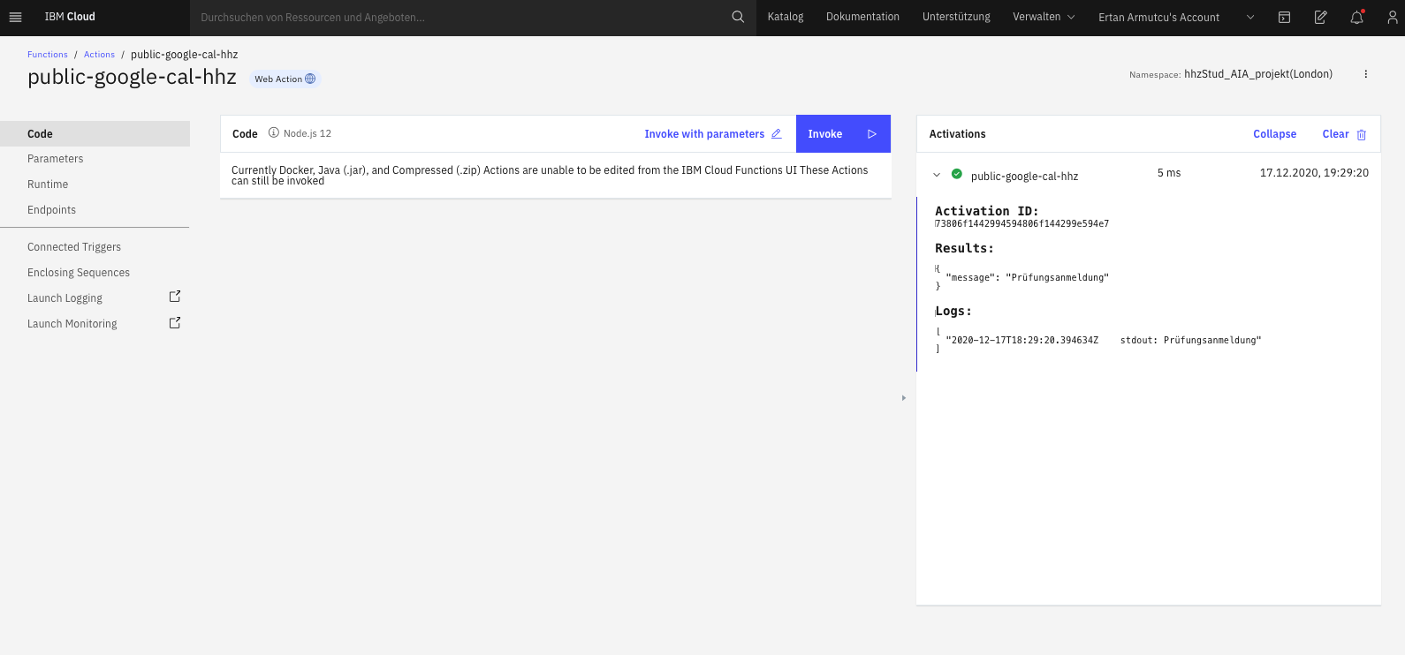
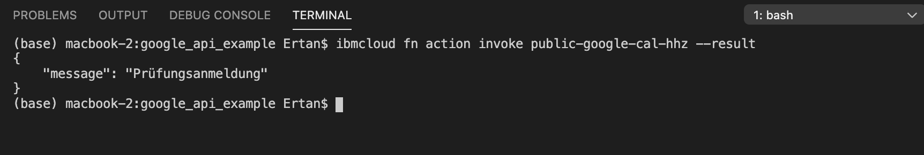
Open Whisk Action: Test Action
Go to https://cloud.ibm.com/functions/actions
Open your uploaded OpenWhisk action
Click on „INVOKE“
You should see the summary of the first element in the events list as result message
Alternatively run the following in the terminal to test your OpenWhisk Action locally The result should be the same
ibmcloud fn action invoke public-google-cal-hhz --result
Link to original repo: https://github.com/IBM/alexa-skill-watson-assistant

Slide 45
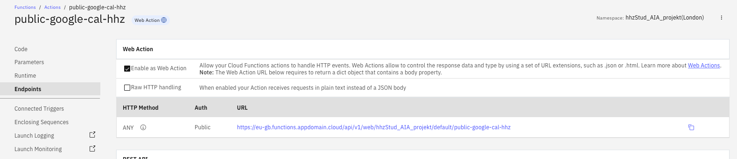
Webhook: Get Webhook Endpoint URL
Open your created OpenWhisk Aciton and click on “Endpoints” on the left side bar
Copy the URL for the HTTP Method
Note: Make sure Raw HTTP Handling is disabled if you want to send parametes to your Web Action through Watson Assistant. Since Watson sends his variables as JSON it is important that this is disabled.
For example in our case we want to send the subject names as variables and then search for the next lecture date in the calendar and response with the date.
Source: https://github.com/IBM/alexa-skill-watson-assistant

Slide 46
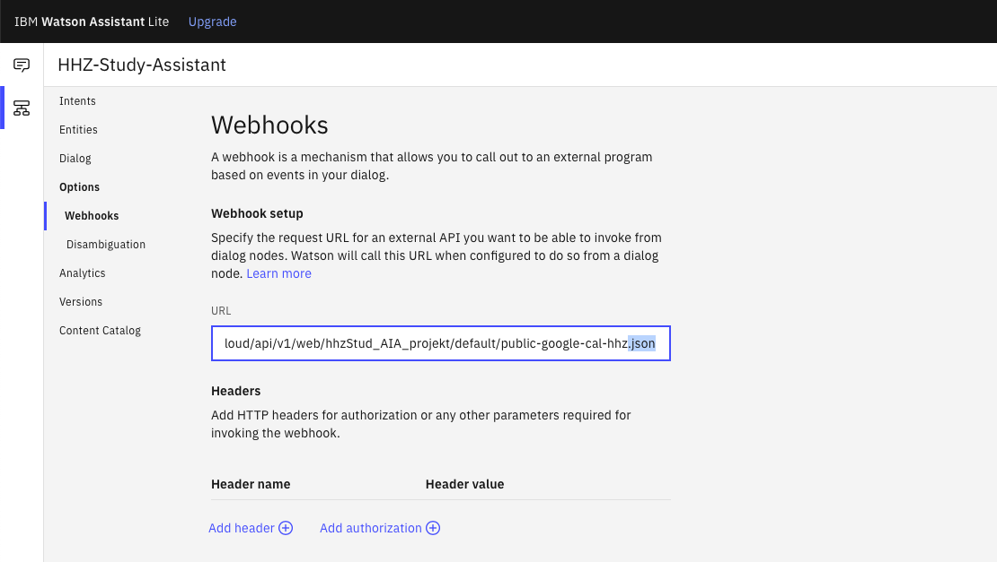
Webhook: Set Webhook Endpoint URL
Launch your Watson Assistant and navigate to your Dialog Skill and click on “Options” and then “Webhooks” on the left side bar
Paste your copied URL from step 2
Add .json as suffix
Source: https://github.com/IBM/alexa-skill-watson-assistant

Slide 47
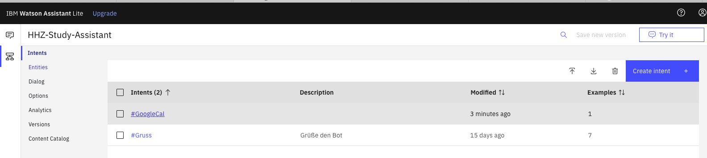
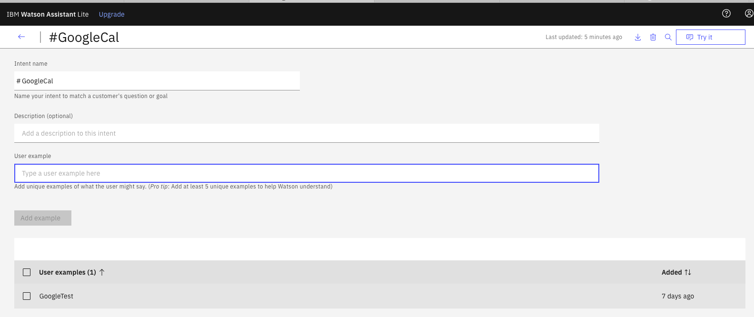
Webhook: Watson Assistant Intent
Click on “Intents” on the left side bar
Create an intent which will invoke our calendar Webhook and add user examples
For illustration purposes the Inten “GoogleCal” with one user example “GoogleTest” is created. When the User types in “GoogleTest” the Webhook should be triggered.
Source: https://github.com/IBM/alexa-skill-watson-assistant

Slide 48
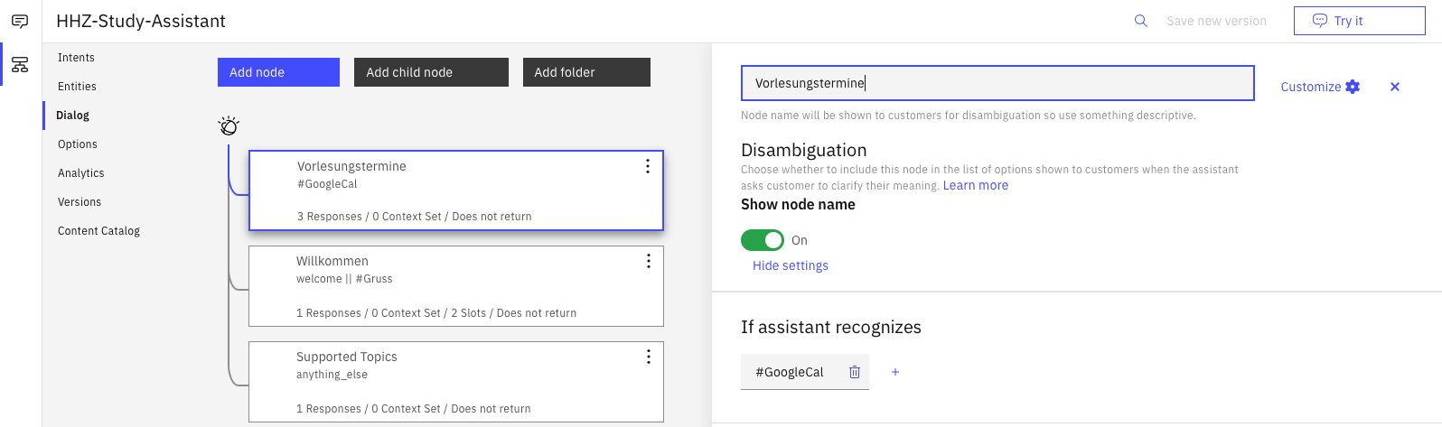
Webhook: Watson Assistant Dialog Node
Click on “Dialog” and add a new dialog node by clicking the “Add node” button.
Name it whatever you want
Make sure the created Intent is selected under “If assistant recognizes”
Next click on “Customize”
Source: https://github.com/IBM/alexa-skill-watson-assistant

Slide 49
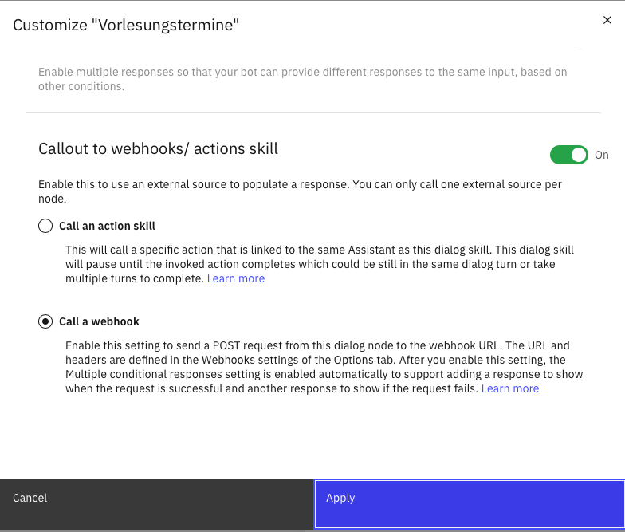
Webhook: Watson Assistant Dialog Node
A new submask will open. Scroll down and enable “Call to webhooks/ actions skill”
Choose “Call a webhook”
Click on “Apply”
Source: https://github.com/IBM/alexa-skill-watson-assistant

Slide 50
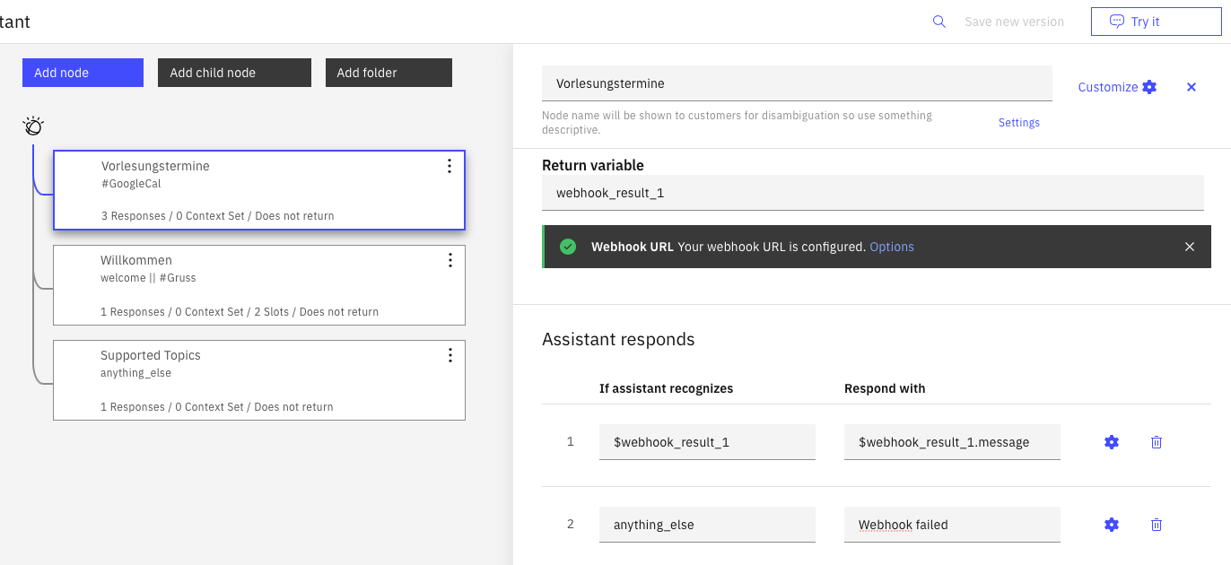
Webhook: Watson Assistant Dialog Node
You should now see the webhook configuration in your node options. Scroll down to “Assistant responds” section
Enter “webhook_result_1.message” for the field “Respond with”
DONE! We can now test our Chatbot by clicking “Try it” on the top right corner
Source: https://github.com/IBM/alexa-skill-watson-assistant

Slide 51
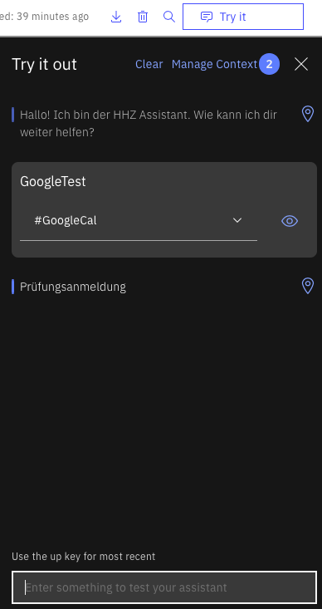
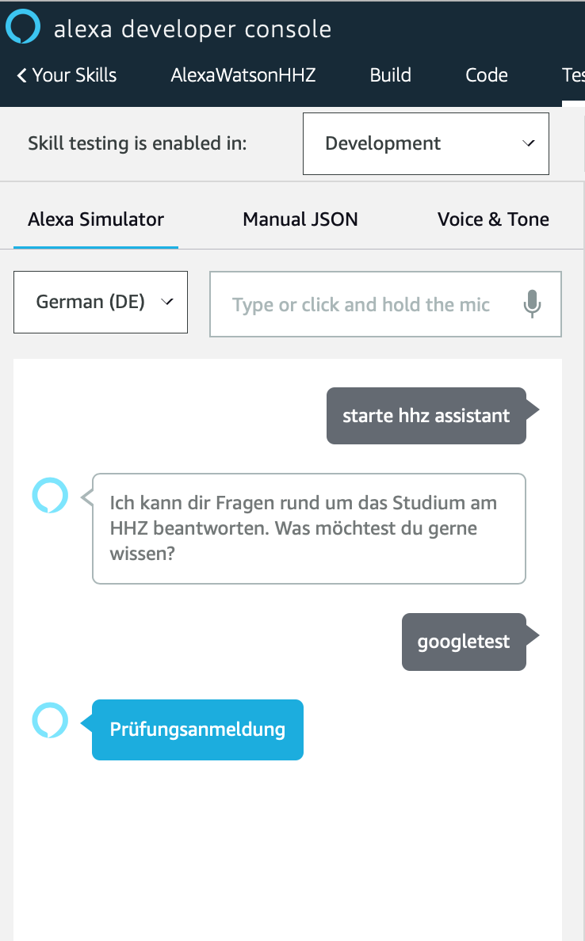
Webhook: Test your Webhook
Enter the user example you configured in your intent which will invoke the google calendar webhook
Your Chatbot should response with the message transmitted from the OpenWhisk action. In our case “Prüfungsanmeldung”.
As you can see it also works with alexa.
Source: https://github.com/IBM/alexa-skill-watson-assistant

